Slide 1
Friday, October 9, 2015
What are 3 reasons that countries go to war?

Slide 2
Objectives
Students will be able to describe the origins of World War I.
Students will be able to explain tensions that were building in Europe prior to the war.
Students will be able to describe how Germany rose as a world power.

Slide 3
Every war was terrible and had large loss of life and even though we will cover the battles that occurred during WWI, it is important to remember that the causes and the aftermaths of all wars is much more important than the battles themselves.

Slide 4
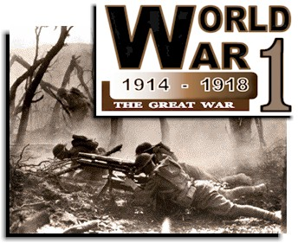

Slide 5
What is “The Great War”?

Slide 6
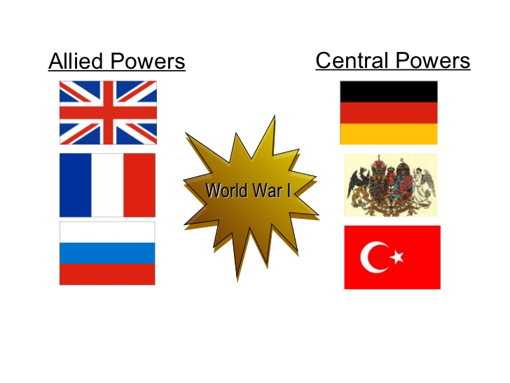
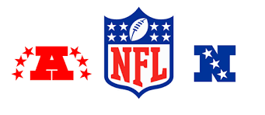
Understanding the Tensions in Europe
NFL: Divided into the AFC and the NFC.
Multiple different teams on each side.
Think of all the countries involved in the war as the NFL. The two battling sides in WWI are the AFC and the NFC.
In both the AFC and the NFC, there are multiple different teams that compete against each other (each of the different countries).

Slide 7
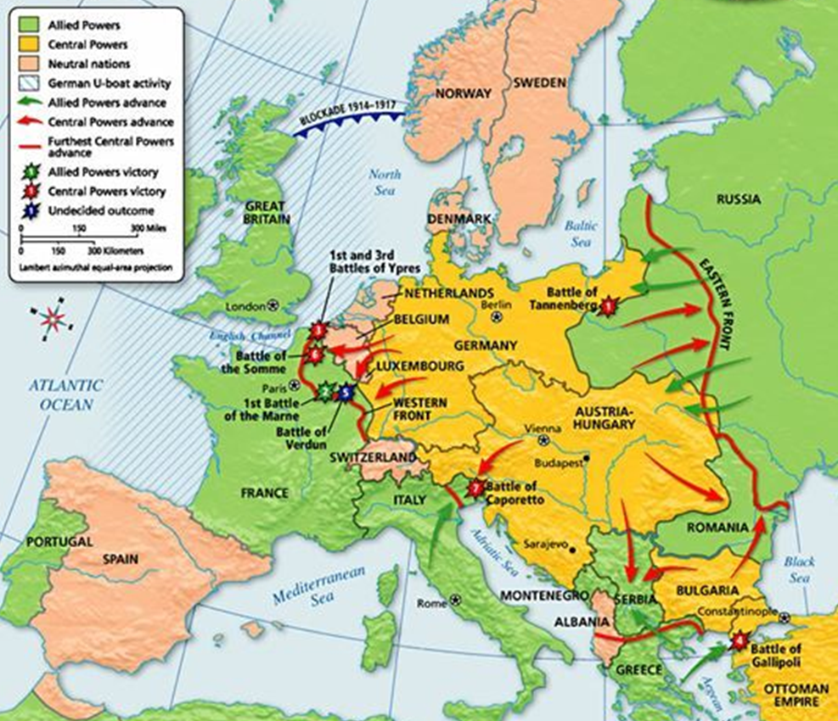
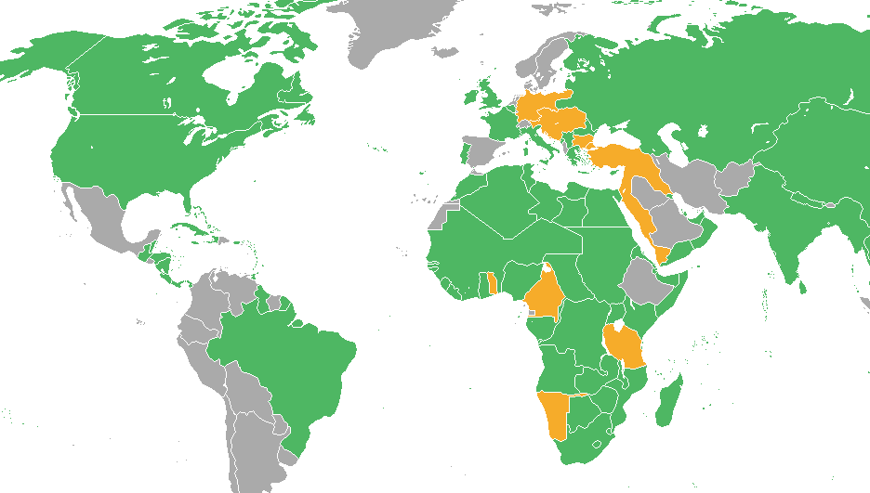
- WWI – Who was at war with each other? - All the countries in green were on one side - All the countries in yellow were on the other side - The nations in Africa are highlighted because they were European colonies which were taken over. They were not independent nations assisting the other nations Most of the battles in WWI took place in Europe

Slide 8
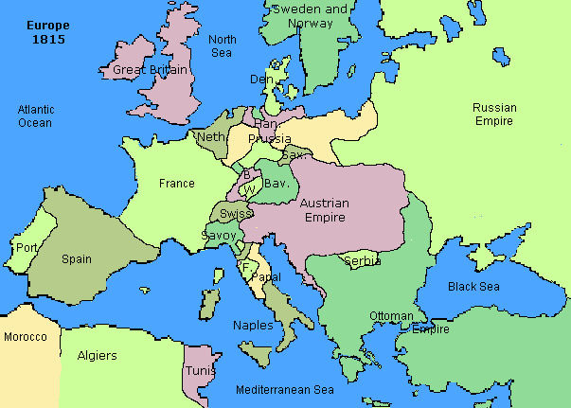
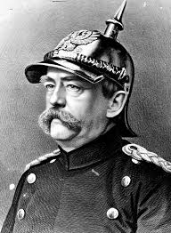
The Rise of Germany (1862 to1871)
Prussia – one of many states in the region of Germany, Poland and Russia, (these states didn’t always get along).
In 1862, Wilhelm I appointed Otto Von Bismarck chief minister of Prussia. Bismarck immediately began to build up the army, and he claimed that other ethnic Germans admired Prussia for her power.
Otto von Bismarck (Minister of Prussia) – united the German states, promoted German superiority over other ethnicities, (such as Danish and French).
Unified Germany fought 3 wars fought vs: Denmark, Austria and France.

Slide 9
What is national pride?

Slide 10
Unification of the German States (1862 to1871) resulted in:
German nationalism (pride) increased, this caused unification of the German people, as did the feeling of superiority to other ethnic groups.
Germans worked together. Unification showed the people that in order to industrialize and make profits, as well as becoming a world power, the German states would have to stick together and support each other.
Franco-Prussian War 1870 – Germany defeated France, took their land which was rich in raw materials (steel and coal).
German Empire became a world power. January 18, 1871, Otto von Bismarck officially proclaimed the German Empire.

Slide 11
Review
How did the German Empire become a world power?

Slide 12
Europe before WWI

Slide 13
Modern-Day Europe

Slide 14
What is different about the two maps?

Slide 15
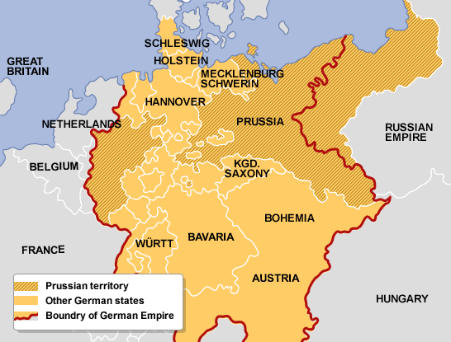
Before and After Unification of German States

Slide 16
Tuesday, October 13, 2015
What was the point of the German Empire? (Hint: It’s in Friday’s notes.)

Slide 17
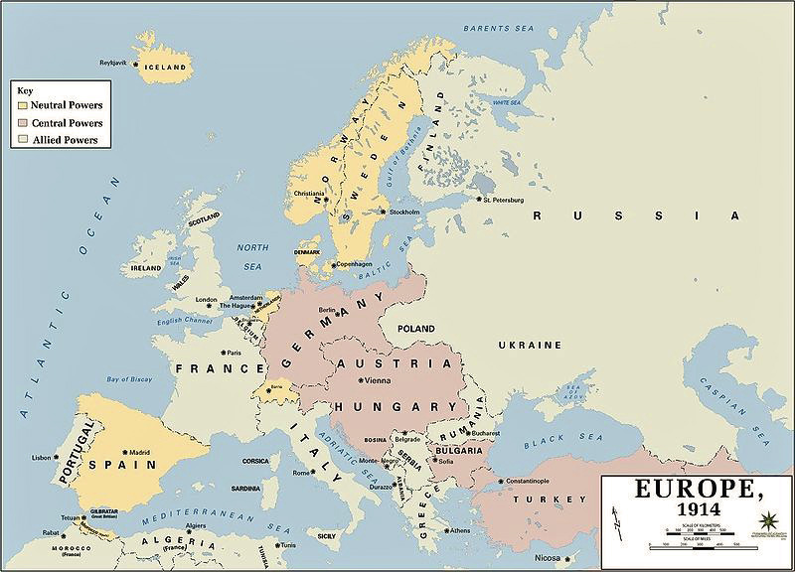
France vs Germany
France was angry at the loss of the Franco-Prussian war and wanted their land back.

Slide 18
Russia vs Germany, A/H, Turkey:
Feared Germany getting more powerful
Angry that Aust/Hun took over Serbia (many Russians and Serbians were of the same ethnicity).
Fought w/Turkey over land.

Slide 19
Germany vs Britain:
Defeated France in the Franco-Prussian War (1870)
After Germany unified in 1871, they wanted to compete with Britain’s navy as a world power.

Slide 20
Austro/Hungarian Empire vs Serbia, Russia
They wanted to expand and become a world power
1878 they took over Bosnia and also wanted Serbia.
Angered at Russia for supporting Serbia

Slide 21
Serbia vs Austria-Hungary:
Serbia was angered when A/H took over Bosnia 1908.
Serbia wanted Bosnia

Slide 22
Great Britain
the only real superpower of the age, only wished to keep the status quo and unlike the other main powers because they already had an enormous empire.

Slide 23
Ottoman Empire (Turkey/Middle East) vs Russia
Fought w/Russia over border territory
Germany pressured them to join them so they wouldn’t join the Allies.
They finally joined Germany & Central Powers.

Slide 24
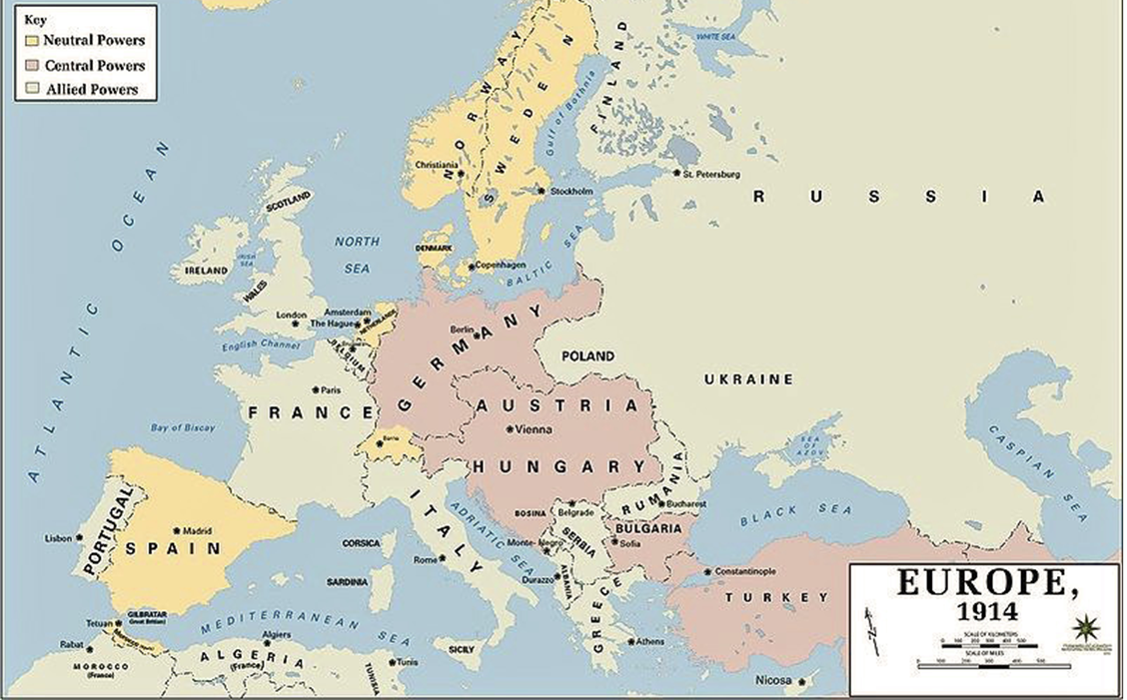
Tension in Europe Pre-WWI
Italy:
Allied itself with A/H & Germany
Once the war began, they changed sides when they saw who the likely victors would be.

Slide 25
Checkpoint (Pg. 618-627)
How did militarism and nationalism push Europe toward war? (Pg. 618-619)
Why did both sides use trench warfare as a strategy to win the war? (Pg. 622)
What German actions led the United States to enter World War I? (Pg. 627)

Slide 26
1. National pride and build up of militaries added to existing tensions.
2. Trenches provided protection from advanced military technology.
3. Germany sunk military ships and Zimmermann note would have started war between U.S. and Mexico if it wasn’t intercepted by British.

Slide 27
https://www.youtube.com/watch?v=fb432yvCxUI (Documentary)
https://video.search.yahoo.com/search/video?fr=yfp-t&p=wwi+youtube#id=4&vid=3eb419975a2c10186193c67a8c5181e3&action=click (Trenches)
https://www.youtube.com/watch?v=6KHoVBK2EVE (Christmas Truce)
https://www.youtube.com/watch?v=WUlPNWDvk-c (Christmas Truce)
https://www.youtube.com/watch?v=tWtETJ0Pt4g (Chemical Warfare)
https://www.youtube.com/watch?v=sh-J4GSPgAM (Christmas Truce – Snoopy vs. the Red Baron)

Slide 28
Thursday, October 15, 2015
Why do empires want to grow?

Slide 29
Causes of WWI
Imperialism (colonization) – forceful takeover of a weaker nation to become more powerful.
*Benefits? Disadvantages?
Nationalism – patriotism for your country.
Militarism – buildup of armed forces to prepare for war
Alliances - a formal agreement between nations to assist the other if they are invaded.
Assassination of the Archduke

Slide 30
Why did European nations imperialize (colonize) others?
To keep expanding their empires. If they allowed one nation to become too strong, they might lose to that country in a war someday.
Need for more raw materials, Africa had an abundance
Expand their markets, sell more products, make more money. they forced the colonized people to buy only their goods.
They needed port cities around the world to stop, get new troops, food/water in order to maintain global dominance

Slide 31
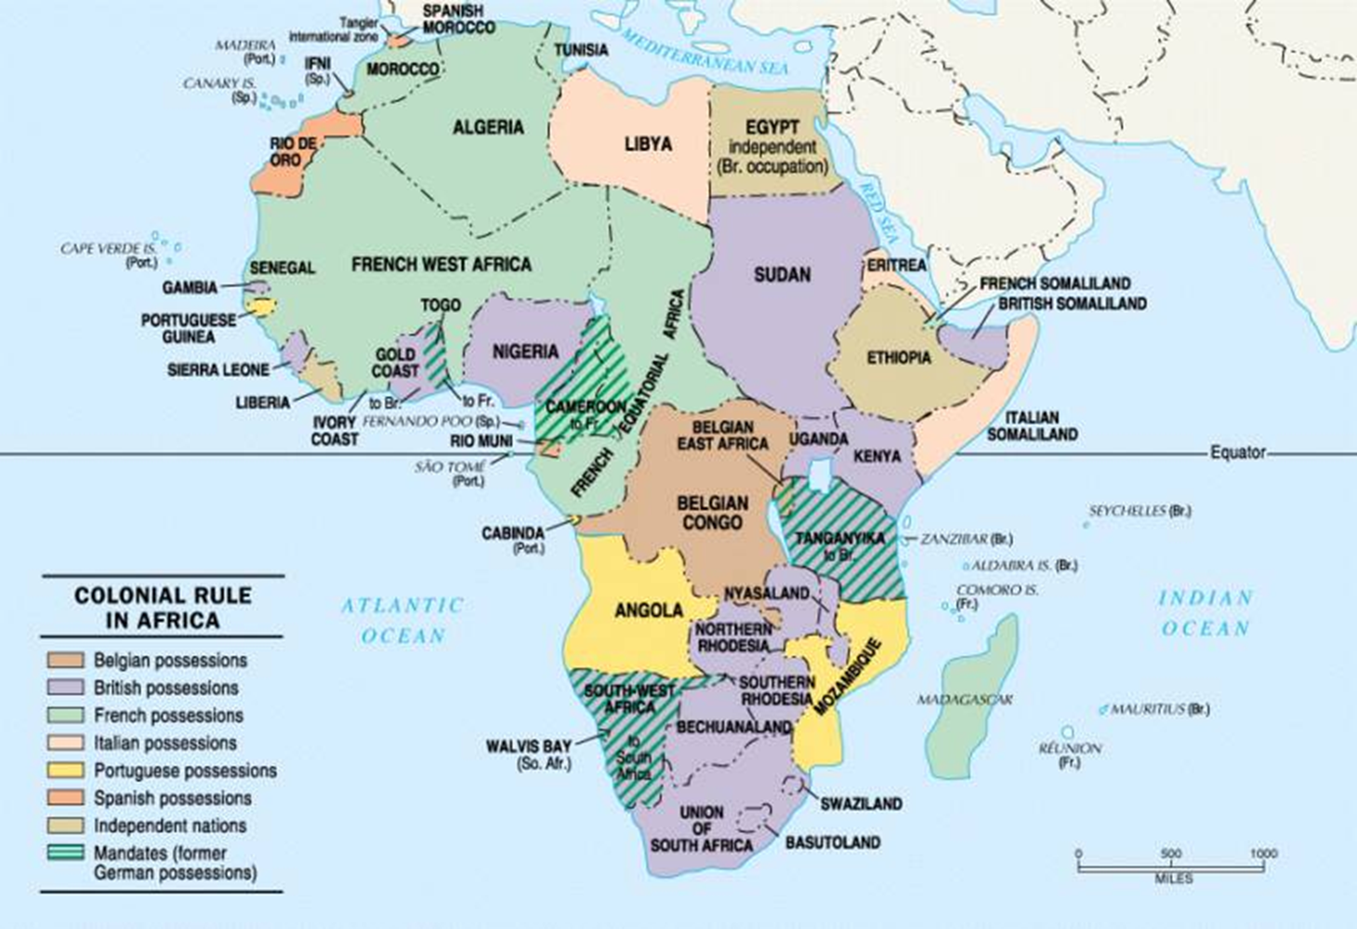
1. Colonization of Africa – Between (1881-1914) 90% of Africa was colonized by European nations. (In 1870, 10% of Africa was under European control; by 1914 it was 90%)

Slide 32
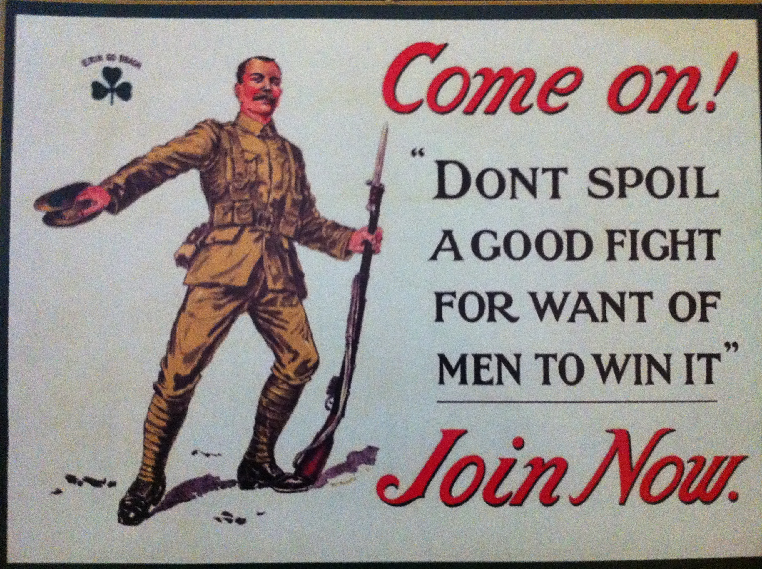
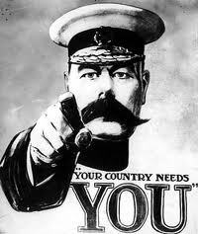
2. Nationalism - extreme patriotism was a significant factor to the outbreak of WW1.
Ethnic differences also played a role in Nationalism.
Each of Europe’s Great Powers developed an excessive belief in its own cultural, economic and military supremacy.
This over-confidence led to a fatal misconception: in the event of war in Europe, one’s own country would be victorious very quickly.

Slide 33
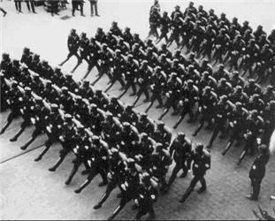
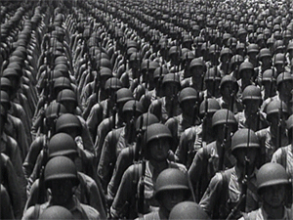
3. Militarism (build up of army/weapons) in Europe a was a major factor to the outbreak of WW1.
The early 1900’s saw the development and production of frightful new weapons, capable of killing on a large scale.
Utilizing new mass-production techniques, Western nations churned out these weapons in large quantities and at a rapid pace.
As tensions increased over colonization, the threat of war loomed and many European nations began amassing large armies.

Slide 34
What is an alliance? Examples?

Slide 36
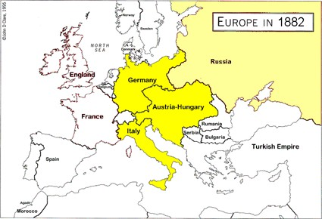
4. Alliance system
Alliance – a group of nations uniting to assist each other for a common cause (in this case it was war)
1882 The Triple Alliance: Ger/Aust-Hung allied against Russia

Slide 37
Monday, October 19, 2015
Why do countries join together during wars? (Review from last week.)

Slide 38
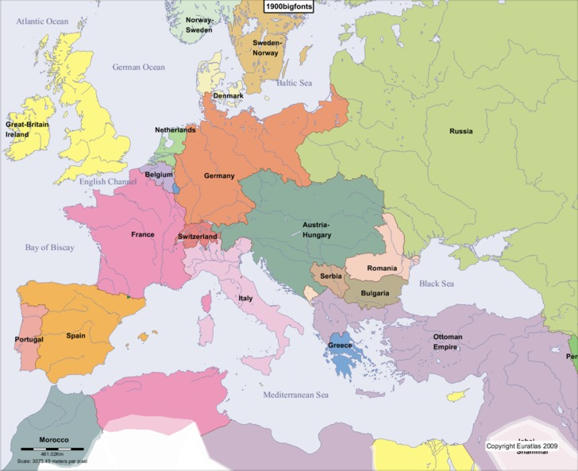
1890 Russia loosely allies with Romania & Bulgaria but so does A/H

Slide 39
1892 Franco-Russian Alliance: Russia and France allied against
Ger/Aust-Hung

Slide 40
1907 The Triple Entente – Britain, France, Russia allied against the threat of Germany
Russia signed the Triple Entente to counter the actions of Aust-Hung and Germany in the Balkans.
1914, Europe was divided between the Triple Alliance (Ger/Aust-Hung/Italy) vs Triple Entente (GBR/Fra/Rus)

Slide 41
WWI 1914-18 Opposing Sides
1. Triple Entente
(Allied Powers)
2. Triple Alliance
(Central Powers)
Great Britain*
Russia*
France*
Serbia
Italy (1915-18)
U.S. (1917-1918)*
* indicates the major nations involved
German Empire*
Aust-Hung Empire*
Ottoman Empire*
Italy (1914-15)

Slide 42
Why do you think the U.S. waited until 1917 to join the war?

Slide 43
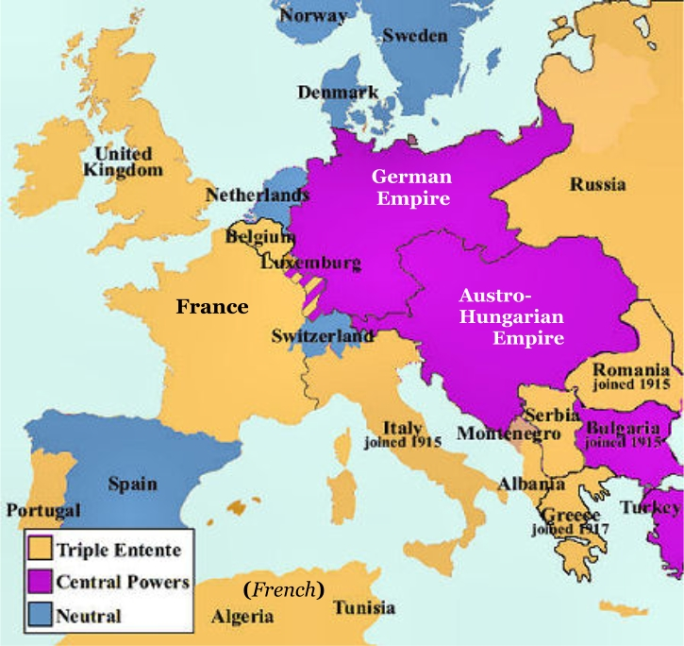
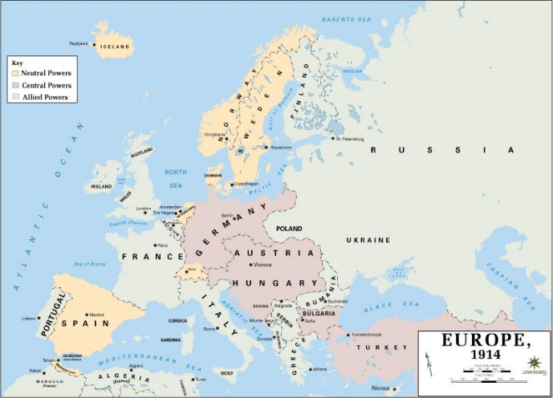
WWI Alliances

Slide 44
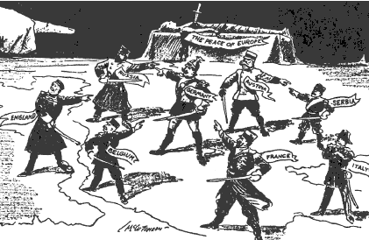
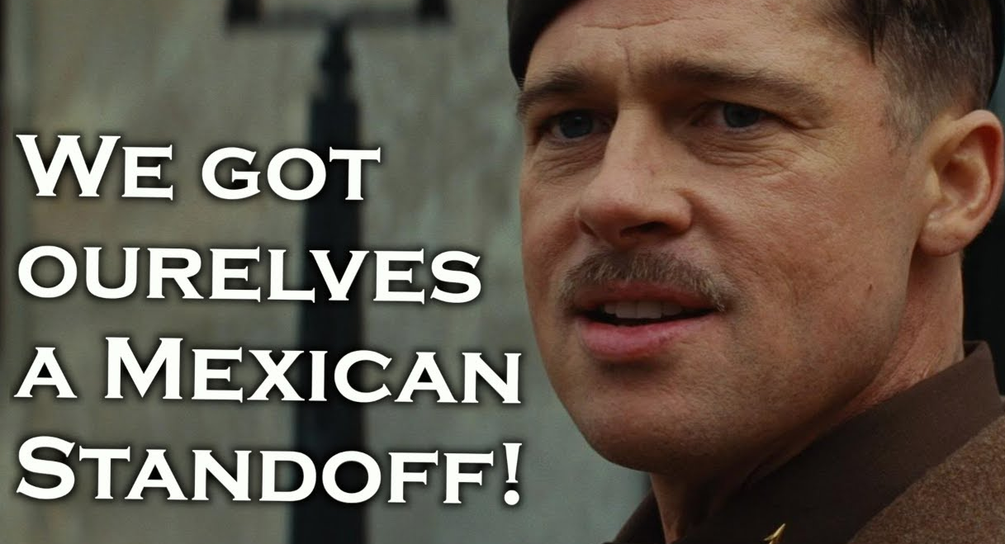
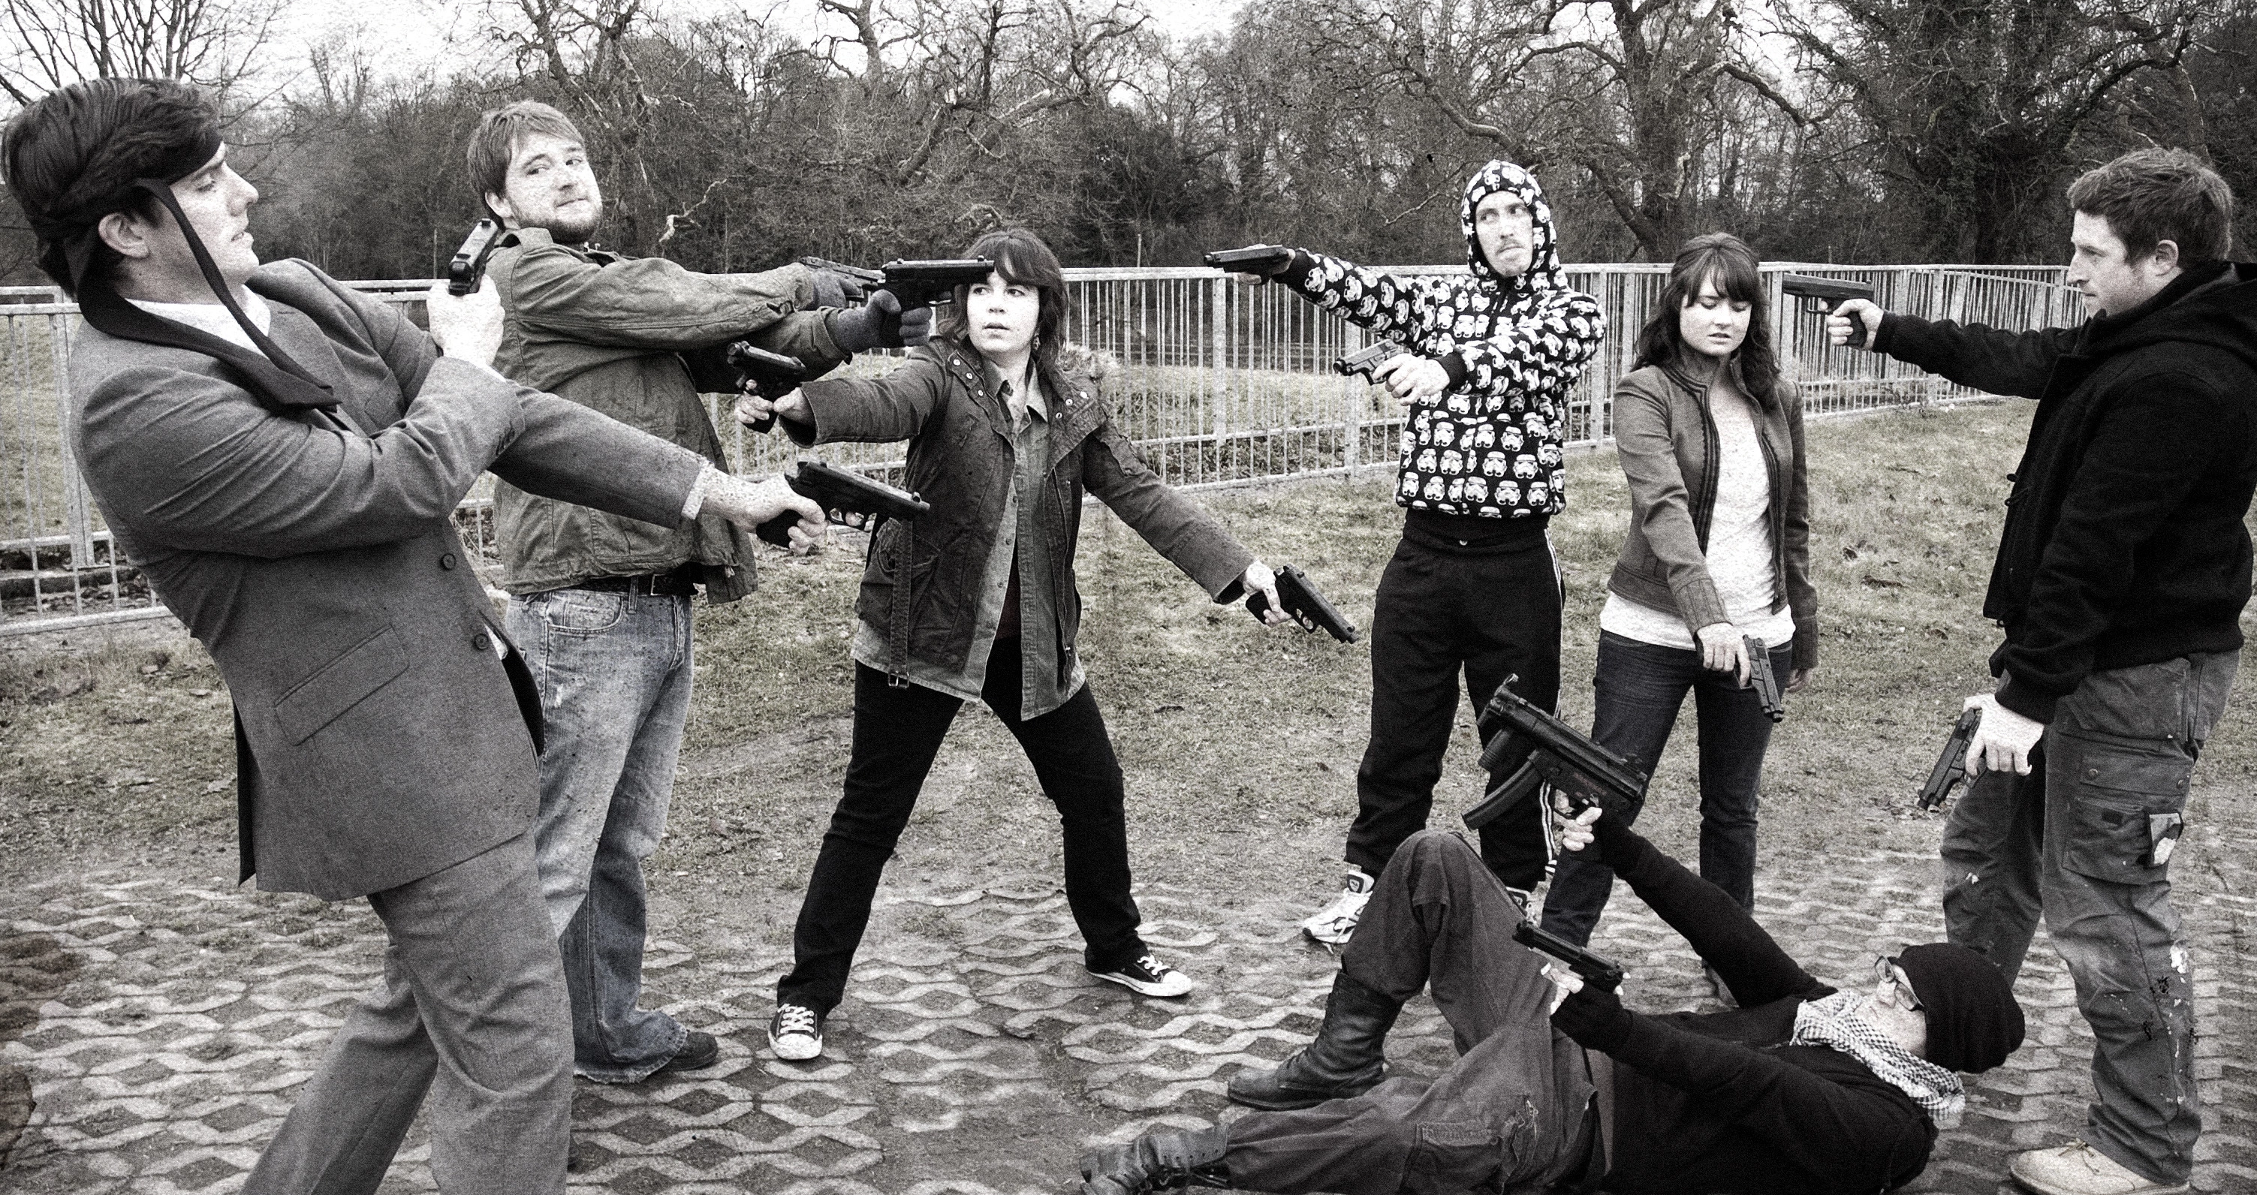
All this tension mounted to the point that every was ready to go to war with each other.
A Mexican standoff is a confrontation between 3 or more parties in which nobody can proceed nor retreat without being exposed to danger. All participants need to maintain the strategic tension or a shootout will ensue.

Slide 45
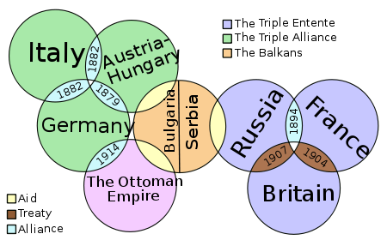
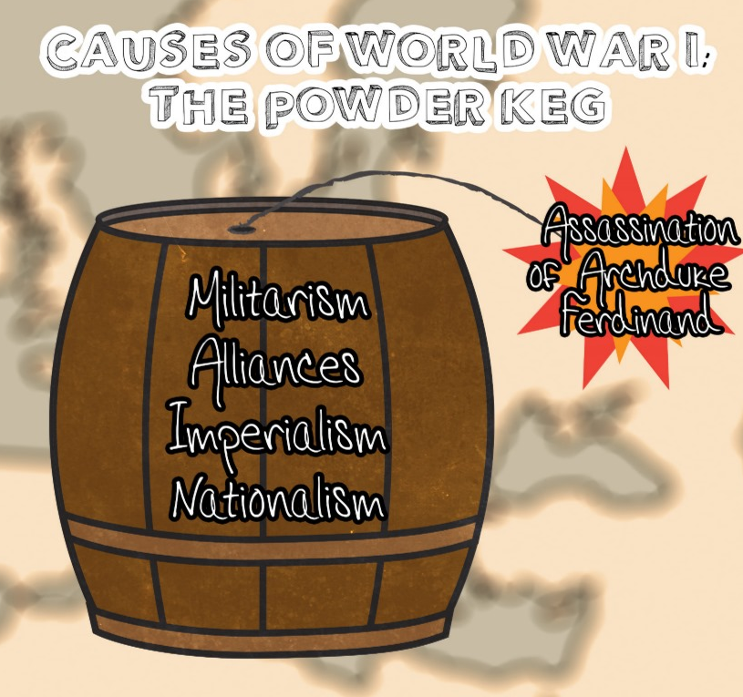
Powder Keg of Europe:
tension increased to the point that war would break out with the smallest skirmish.
When the Archduke Ferdinand was assassinated, WW1 “powder keg” ignited.
“The straw that broke the camel’s back.”

Slide 46
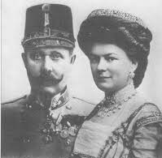
The assassination of Archduke Ferdinand was the spark that started WWI in 1914 but not the real cause of it.
The event, known as the Assassination in Sarajevo, was the spark that ignited World War I in 1914
June 28, 1914, Franz Ferdinand, the heir to the Austrian throne, and his wife were killed by a Serbian terrorist group, the Black Hand, in Sarajevo, Bosnia-Herzegovina, a state within the Austro-Hung Empire.

Slide 47
Tuesday, October 20, 2015
What did the assassination of the Archduke Ferdinand lead to? (Hint: It’s in yesterday’s notes.)

Slide 48
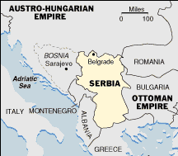
Why did Serbians kill the Archduke?
Bosnia was originally part of Serbia
Aust/Hun defeated Serbia and took over Bosnia to expand its empire (imperialism/colonization).
Bosnia resented Aust-Hung and wanted it back for Serbia Franz Ferdinand was heir to the Austrian throne.

Slide 49
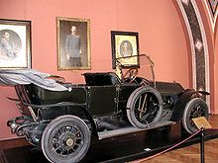
The Assassination of Franz Ferdinand
The Archduke Ferdinand and his wife Sophie traveled to Sarajevo, Bosnia to inspect his army and show his presence in Bosnia as their future leader.
6 assassins were lined up in various spots along the motorcade trying to kill them.
The first failed to throw a bomb, the 2nd threw a bomb but it missed them and injured many civilians.
The assassins followed the royal couple who were now very nervous about their own safety.
The archduke and wife were approached by the other assassins and shot and killed in their car after visiting the injured (from the earlier bombing).
Sophie died instantly, Franz Ferdinand was then shot in the jugular.

Slide 50
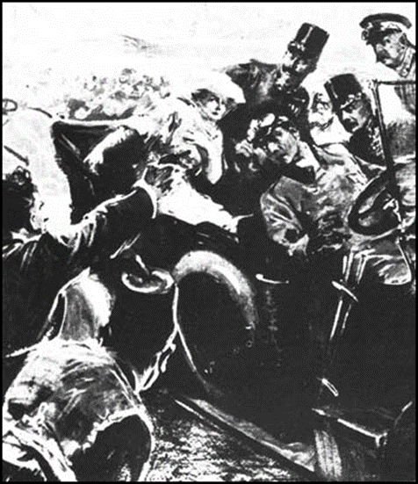
Gavrillo Princip:
19 yr-old Serbian, member of the Black Hand, one of the assassins of the archduke.
Black Hand – Serbian terrorist group, they wanted Serbia back for a united Yugoslavia, They killed the archduke
Gavrillo came from a very poor family who could not afford to feed him and sent him to live with an older brother in Sarajevo.
He was a poor, sickly teenager and this might have contributed to his “nothing to lose” attitude.
He was too young to receive the death penalty but received the maximum sentence of 20 years in prison where he contracted tuberculosis and died on 28 April 1918, almost 4 years after he assassinated the Archduke and Duchess.

Slide 51
What Happens From There?
Austria-Hungary demanded justice from Serbia:
Including the following:
An official apology
The arrest of all Black Hand members
Austrian troops to be stationed in Serbia to monitor the acceptance of the ultimatum
Serbia rejected enemy troops to be placed in Serbia.
Austria-Hungary declared war against Serbia

Slide 52
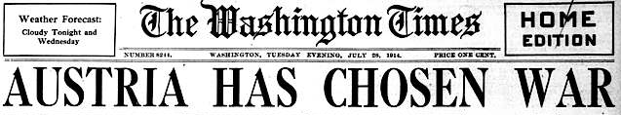
Once war is declared, alliances go into effect, WW1 begins
Domino effect - once one nation declared war all other nations soon followed due to the alliances they agreed to.
Mobilization - Getting troops/supplies moved, ready for war.
Summer 1914:
Russia mobilizes army along borders with Austria and Germany
Germany declares war on Russia & France
France mobilizes forces to assist Russia
Germany invades Belgium
Britain declares war on Germany

Slide 53
Wednesday, October 21, 2015
Why did the Black Hand members assassinate Archduke Franz Ferdinand? (Hint: It’s in yesterday’s notes.)

Slide 54
Quiz Friday: Terms
Alliance Militarism Black Hand Mobilization Domino Effect Nationalism Franco-Prussian War Otto von Bismarck Gavrillo Princip 1892 Franco-Russian Alliance

Slide 55
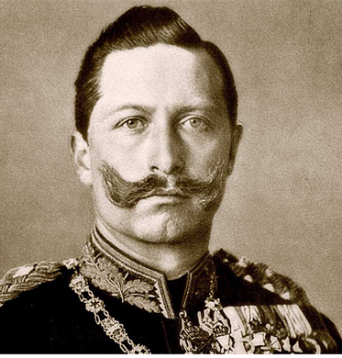
Kaiser Wilhelm II: German Monarch Reign: 1888-1918
Hated the British and Russians due to his family ties
Wanted to make Germany a world power.

Slide 56
One interesting aspect of WW1 is the close connection among the three principal leaders: Kaiser Wilhelm II of Germany, King George V of England and Tsar Nicholas II of Russia were all cousins
Wilhelm and George were first cousins, George and Nicholas were also first cousins, and Wilhelm and Nicholas were 3rd cousins.
Wilhelm was born with a crippled arm thanks and and had a strained relationship with his English mother, Victoria who was 17 when she married Prussia’s Prince Friedrich, in 1858. His grandmother was Queen Victoria of England
Wilhelm's hatred of his mother, and all things British, in part, brought about the beginning of the First World War.

Slide 58
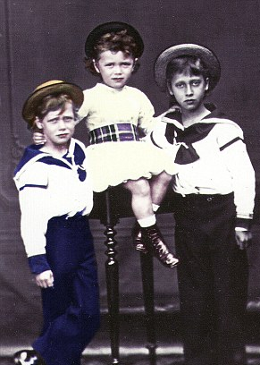
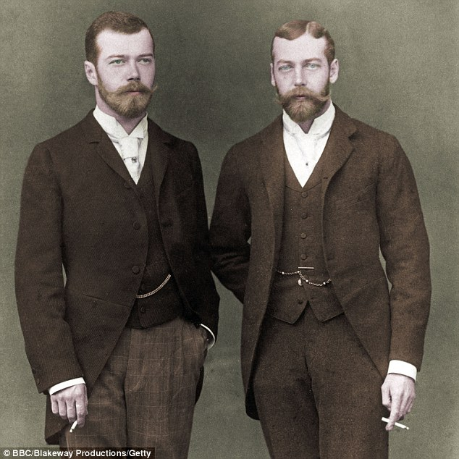
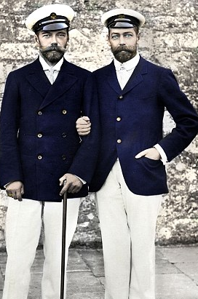
Tsar Nicholas II and King George V were cousins and close friends since childhood

Slide 59
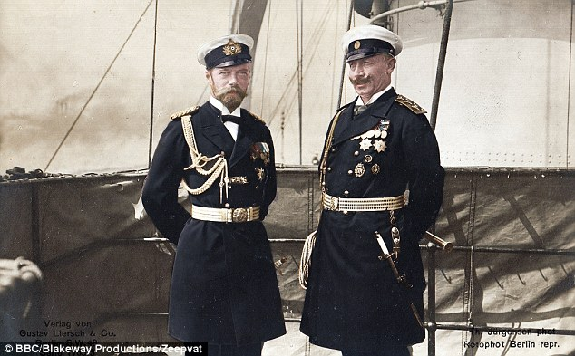
Although related twice over, Tsar Nicholas II and Kaiser Wilhelm were not close friends.
Why were they not close friends?

Slide 60
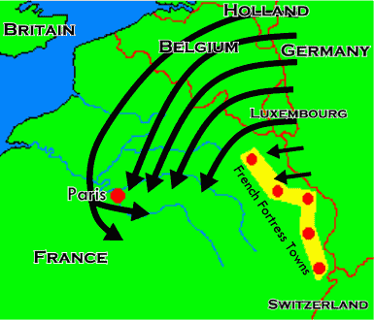
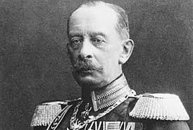
Schlieffen Plan (1905)
A plan for a German victory over the Franco-Russian alliance by holding off Russia with little strength and quickly defeating France by moving through the Low Countries (the Netherlands and Belgium).
It failed when it was used in World War I (1914).
Alfred von Schlieffen

Slide 61
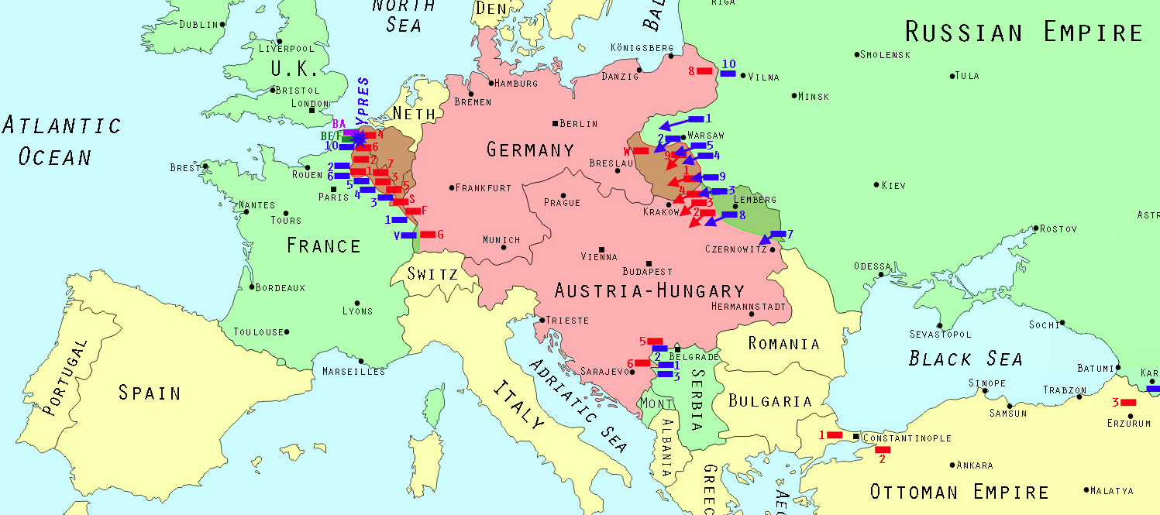
Western Front
Eastern Front
Western Front
Central Powers
Allied Powers
In Summer 1914 two battlefronts began:
Front (Frontline) – this is where the fighting was taking place between opposing soldiers.
Western Front – battlefield stretching across France & Belgium near the German border.
Eastern Front – battlefield stretching across the German-Austrian-Russian borders.
Is this an advantage or disadvantage for Germany & Aust?

Slide 62
Friday, October 23, 2015
What was the problem with Germany having 2 frontlines? (Review from yesterday’s class.)

Slide 63
Quiz Monday: Terms
Alliance Militarism Black Hand Mobilization Domino Effect Nationalism Franco-Prussian War Otto von Bismarck Gavrillo Princip 1892 Franco-Russian Alliance

Slide 64
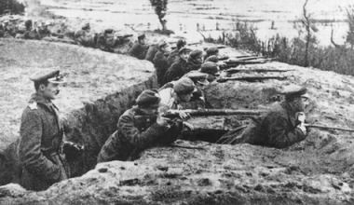
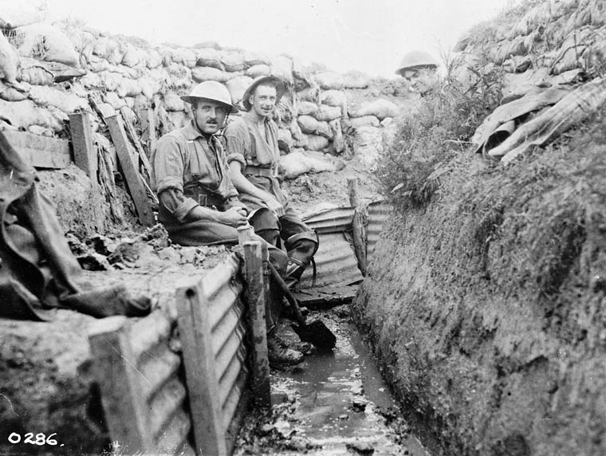
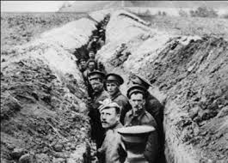
Trench Warfare - type of combat where opposing troops fight from opposing trenches (facing each other).
Because of trenches, neither side advanced, led to stalemate.
Stalemate – as both sides settled into trenches, no land was lost or gained.
Trench warfare - https://www.youtube.com/watch?v=FvYIIuxh2kY Trench warfare - https://www.youtube.com/watch?v=G9iR0xJW-Fk

Slide 65
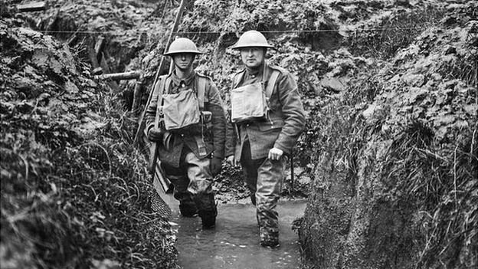
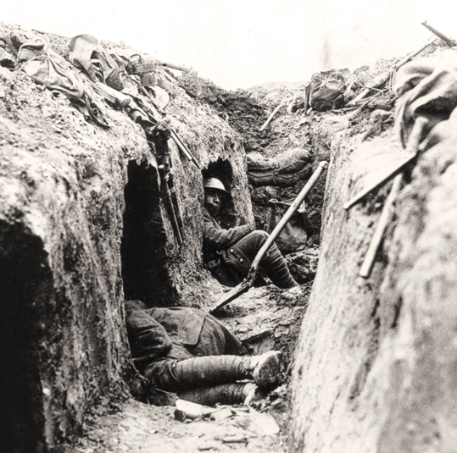
Life in the Trenches
Trench warfare took place on the Western Front
Trenches were long, narrow ditches dug into the ground where soldiers lived all day and night. There were many lines of German trenches on one side and many lines of Allied trenches on the other. In the middle, was no man's land, so-called because it did not belong to either army. Soldiers crossed No Man's Land when they wanted to attack the other side. Soldiers in the trenches did not get much sleep. When they did, it was in the afternoon during daylight and at night only for an hour at a time. During rest time, they wrote letters or played card games. The trenches could be very muddy and smelly. There were many dead bodies buried nearby and the latrines (toilets) sometimes overflowed into the trenches. Millions of rats infested the trenches and some as big as cats. Lice also tormented the soldiers on a daily basis.

Slide 66
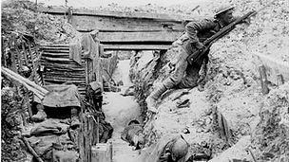
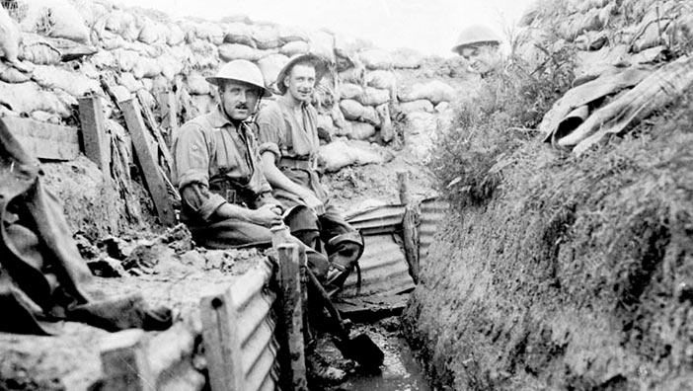
A typical day in the trenches:
5am - 'Stand-to' (short for 'Stand-to-Arms', meaning to be on high-alert for enemy attack) half an hour before daylight
5.30am - Rum ration
6am - Stand-to half an hour after daylight
7am - Breakfast (usually bacon and tea)
After 8am - Clean themselves, clean weapons, tidy trench
Noon - Dinner
After dinner - Sleep and downtime (one man per ten on duty)
5pm - Tea
6pm - Stand-to half an hour before dusk
6.30pm - Stand-down half an hour after dusk
6.30pm onwards - Work all night with some time for rest (patrols, digging trenches, putting up barbed wire, getting stores, replacement of unit of soldiers every five days)
http://www.bbc.co.uk/guides/z8sssbk

Slide 67
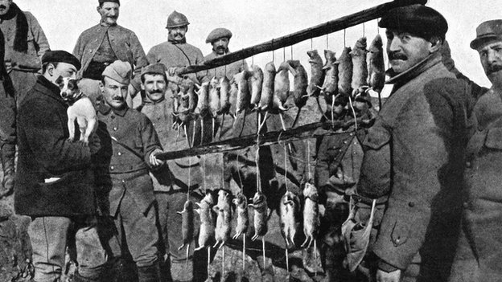
Soldiers living in trenches encountered millions of pests during the war. These made living conditions rather uncomfortable in the trenches.
A little terrier dog shows off its catch after a 15 minute rat hunt in French trenches, September 1916

Slide 68
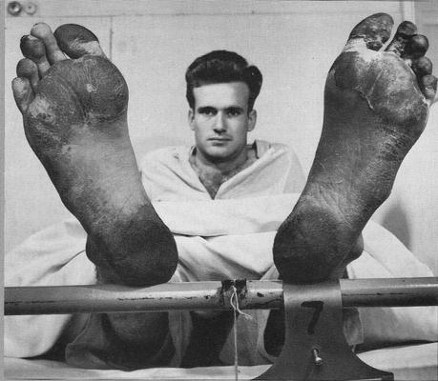
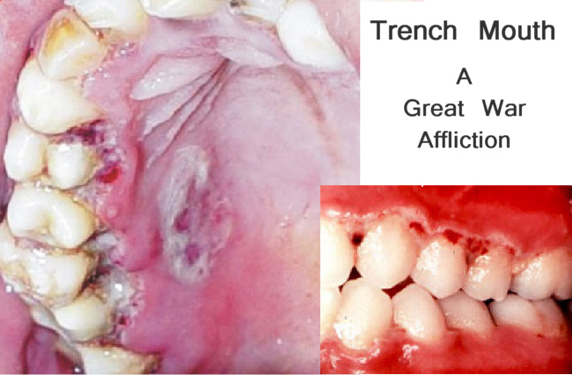
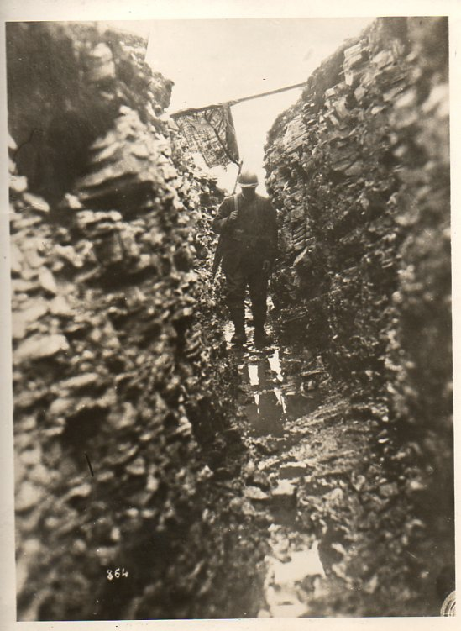
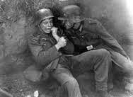
Hazards of WWI Trenches
Dysentery
Trench foot
Trench mouth
Rats, lice
Shell shock

Slide 69
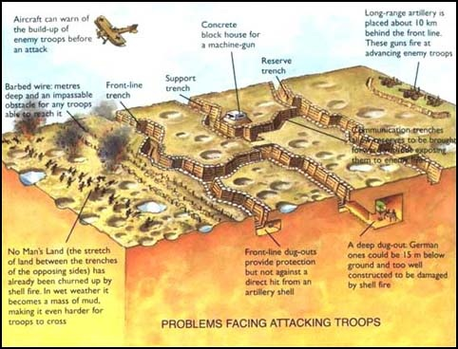
No Man’s Land – the land between the trenches, filled with barbed wire and bomb shell craters
War Horse - https://www.youtube.com/watch?v=0OVRWRi-Zj8
Trench Warfare- https://www.youtube.com/watch?v=P92guhd7d-8

Slide 70
WW1 Trenches are still there today

Slide 71
Friday, October 23, 2015
What are 3 examples of weapons and vehicles used in any war?

Slide 72
First Modern War – WW1 was the first war to use cars, trucks, planes, wireless radio and poison gas.
8 New weapons first used in any war: New technologies of WW1 had a tremendous impact on the strategy and tactics of the war. This is why this war is referred to as the first Modern War.
(4:20) Weapons - https://www.youtube.com/watch?v=PK-6QKc-r9o

Slide 73
Cars/trucks ***
Were first used in WW1 to transport men, weapons, food and supplies

Slide 74
2. Aircraft***
This was the first time airplanes (fighter planes and bombers) were used in war.
Single pilot fighter to several men in a bomber
The planes were constructed of canvas stretched over wooden frame
Fighters were armed with machine guns
Most aerial combat techniques used today came from WW1
Hot air balloons and zeppelins played a role in the war as well

Slide 75
3. Tanks ***
Large armored vehicles armed with machine guns and cannons. Very slow, unreliable, not a real factor.
Used to assault trenches, destroy barbed wire and other obstacles
Somewhat effective depending on use; infantry support, combined arms
Mechanical breakdowns, lack of speed
Armored Car

Slide 76
4. Communications ***
Wireless radio and telephones allowed for faster communications
Wireless radio worked well to notify the enemy’s artillery location
Both sides used codes so the enemy wouldn’t know their plans
Runners and carrier pigeons were still used throughout war though.

Slide 77
5. Submarines ***
U-Boats, Underwater boats used to sneak attack enemy ships

Slide 78
6. Chemical Weapons ***
Poison gas (Mustard gas, chlorine, and “tear gas”) was used in bombs to kill the enemy.
The produced horrible wounds and death
It was very hard to control
Troops had to wear masks which made fighting difficult
Masks were often ineffective

Slide 79
7. Grenades***
Small, hand-thrown bombs, first used in WW1
The F-1 grenade was first put iThese were ideal for trench warfare, they were thrown near the enemy to explode shrapnel (metal fragments) and kill them.
nto mass production by the French in 1915 during WW1.
shrapnel

Slide 80
8. Flamethrower *** - German invention first used in WW1
- Sprayed a large flame to kill the enemy
Designed to be carried by a single man. Pressurized air/carbon dioxide or nitrogen was shot with a stream of burning oil (20 yards). First used by the Germans against the French on the Western Front in late 1914. It turned out to be a very powerful weapon but it had a limited range and difficult to operate but the Germans continued to use it until the end of the war. The French and British later developed flamethrowers as well but never used the weapon on the same scale as their opponents.

Slide 81
United States History II Quiz Name: _________________________________________________________ Date: _______________________ Period: _____ Word Bank: Alliance Militarism Black Hand Mobilization Domino Effect Nationalism Franco-Prussian War Otto von Bismarck Gavrillo Princip 1892 Franco-Russian Alliance
______________________________ Germany defeated France, took their land which was rich in raw materials.
______________________________ A group of nations uniting to assist each other for a common cause.
______________________________ 19 year-old Serbian, member of a terrorist group, one of the assassins of the archduke.
_______________________________ Build up of army/weapons.
______________________________ Extreme patriotism for your country.
_______________________________ Russia and France allied against Germany/Austria-Hungary.
_______________________________ Serbian terrorist group, they wanted Serbia back for a united Yugoslavia, They killed the archduke.
______________________________ Once one nation declared war, all other nations soon followed due to the alliances they agreed to.
_______________________________ Getting troops/supplies moved, getting ready for war.
______________________________ Minister of Prussia, united German states, promoted German superiority over other ethnicities.

Slide 82
United States History II Quiz Name: _________________________________________________________ Date: _______________________ Period: _____ Word Bank: Alliance Militarism Black Hand Mobilization Domino Effect Nationalism Franco-Prussian War Otto von Bismarck Gavrillo Princip 1892 Franco-Russian Alliance #1-5: Alliance, Franco-Prussia War 1870, Militarism, Gavrillo Princip, Nationalism #6-10: Black Hand, Domino Effect, Otto von Bismarck, Mobilization, 1892 Franco-Russian Alliance
______________________________ Germany defeated France, took their land which was rich in raw materials.
______________________________ A group of nations uniting to assist each other for a common cause.
______________________________ 19 year-old Serbian, member of a terrorist group, one of the assassins of the archduke.
_______________________________ Build up of army/weapons.
______________________________ Extreme patriotism for your country.
_______________________________ Russia and France allied against Germany/Austria-Hungary.
_______________________________ Serbian terrorist group, they wanted Serbia back for a united Yugoslavia, They killed the archduke.
______________________________ Once one nation declared war, all other nations soon followed due to the alliances they agreed to.
_______________________________ Getting troops/supplies moved, getting ready for war.
______________________________ Minister of Prussia, united German states, promoted German superiority over other ethnicities.

Slide 83
United States History II Quiz Name: _________________________________________________________ Date: _______________________ Period: _____
______________________________ Germany defeated France, took their land which was rich in raw materials.
______________________________ A group of nations uniting to assist each other for a common cause.
______________________________ 19 year-old Serbian, member of a terrorist group, one of the assassins of the archduke.
_______________________________ Build up of army/weapons.
______________________________ Extreme patriotism for your country.
_______________________________ Russia and France allied against Germany/Austria-Hungary.
_______________________________ Serbian terrorist group, they wanted Serbia back for a united Yugoslavia, They killed the archduke.
______________________________ Once one nation declared war, all other nations soon followed due to the alliances they agreed to.
_______________________________ Getting troops/supplies moved, getting ready for war.
______________________________ Minister of Prussia, united German states, promoted German superiority over other ethnicities.

Slide 84
United States History II Quiz – Answer Key Name: _________________________________________________________ Date: _______________________ Period: _____ Word Bank: Alliance Militarism Black Hand Mobilization Domino Effect Nationalism Franco-Prussian War Otto von Bismarck Gavrillo Princip 1892 Franco-Russian Alliance #1-5: Alliance, Franco-Prussia War 1870, Militarism, Gavrillo Princip, Nationalism #6-10: Black Hand, Domino Effect, Otto von Bismarck, Mobilization, 1892 Franco-Russian Alliance
Franco-Prussian War 1870 ________ Germany defeated France, took their land which was rich in raw materials.
Alliance_______________________ A group of nations uniting to assist each other for a common cause.
Gavrillo Princip_________________ 19 year-old Serbian, member of a terrorist group, one of the assassins of the archduke.
Militarism______________________ Build up of army/weapons.
Nationalism____________________ Extreme patriotism for your country.
1892 Franco-Russian Alliance_______ Russia and France allied against Germany/Austria-Hungary.
Black Hand_____________________ Serbian terrorist group, they wanted Serbia back for a united Yugoslavia, They killed the archduke
Domino effect ___________________ Once one nation declared war, all other nations soon followed due to the alliances they agreed to.
Mobilization______________________ Getting troops/supplies moved, getting ready for war.
Otto von Bismarck _________________ Minister of Prussia, united German states, promoted German superiority over other ethnicities.

Slide 85
Monday, October 26, 2015
Review for today’s quiz.

Slide 86
Tuesday, October 27, 2015
What were 3 new technologies first used in World War I? (Hint: It’s in yesterday’s notes.)

Slide 87
New and Improved Weapons of WW1

Slide 88
9. MACHINE GUNS - Rapid-fire rifles used to spray bullets at a group of enemy. (Not the first time used in war)
This was not the first war to use machine gun (Gatlin gun-Civil War) but this weapon was much improved and more portable than the Gatlin gun)
400-800 rounds/minute), typically crewed by several men, Belt-fed .30 cal (typical)
Possibly the most influential weapon of the war, it contributed to stalemate and affected tactics and no longer would massed infantry be the most effective. They were also mounted on airplanes and armored vehicles.

Slide 89
Howitzer – German artillery used for WW1
It had an 8 mile range. Inside barrel dia-16.5”
10. Long Range Artillery
Large cannon able to shoot long distances.
This was not the first war to use cannon, but they were much improved and could reach much longer distances and caused greater damage.
Operated by a small group of men
Although mortars like these were used in prior wars, these had improved accuracy, range, shells, fuses, Faster reload, more portable.

Slide 90
5 Deadliest Weapons of WW1
German Maxim MG 08
Machine Gun
British Mark V tank
German Tri-Plane
German
Big Bertha Howitzer
German Type 93 U-Boat

Slide 91
While trench warfare is synonymous with WW1, only a small proportion of soldiers actually served there. The trenches were the front lines, the most dangerous places for the infantry. Close behind them was a mortars and machine-guns, supporting troops, a massive supply line, and officers headquarters. The idea of digging into the ground to give some protection from powerful enemy artillery and small arms fire was not a new idea or unique to the Great War. It had been widely practiced in the US Civil War, the Russo-Japanese war and others. Trench warfare can be said to have begun in September 1914 and ended when the Allies made a breakthrough attack in August 1918. Before and after those dates were wars of movement: in between it was a war of entrenchment. The massive armies of 1914 initially fought a war of movement, and any trenches dug were only for temporary cover. But from the Battle of the Aisne onwards, both sides dug in to take cover and hold their ground. The successive movements to outflank (get around the outside of) the enemy trenches came to an end by November 1914. By then there was a continuous line of trenches covering some 400 miles from Switzerland to the North Sea. There was no way round.
The type and nature of the trench positions varied a lot, depending on the local conditions. For example, in the area of the River Somme on the Western Front, the ground is chalky and is easily dug. The trench sides will crumble easily after rain, so would be built up with wood, sandbags or any other material. At Ypres, the ground is naturally wet and soggy, so trenches were not really dug, more built up using sandbags and wood to create walls. In some parts trenches were dug in rock or sand. In France the trenches ran through towns and villages, through industrial works, coalmines, brickyards, across railway tracks, through farms, fields and woods, across rivers, canals and streams. Each feature presented its own set of challenges for the men who had to dig in and defend. In the major offensives of 1915, 1916 and 1917 many trench positions were only held for a few days at a time before the next advance moved them on into what had been no man's land or the enemy position.
There is a front line, or "Main Fire Trench" facing the enemy. It is not straight, but follows contours or other natural features allowing good defense or a view over the enemy lines. Thousands of men became casualties in fighting for, or making small adjustments to their lines, to give this cover or observation. It also is dug in sections rather than a straight line, so if a shell explodes inside one of these 'bays' (also called 'traverses'), or an enemy gets into one, only that section is affected. Behind it is another line, similarly made, called a support line. In this would be found 'dugouts' cut into the side of the trench wall, often very small but with room for perhaps three or four men to squeeze in for shelter, or for a telephone position for a signaller, or for a Platoon or Company HQ. Communication trenches linked the rear areas with both lines, and it was along these that all men, equipment and supplies had to be fetched, by hand. Probing out from the front line were trenches usually called 'saps', which often went beyond the protective belts of barbed wire, terminating somewhere in 'no man's land' between the two opposing front lines in a listening post, manned by one or two infantrymen. The cross-section shows how the front and rear of the trench was ideally protected and built up using sandbags at the front and rear, or 'parapet' and 'parados'.
The enemy had a very similar system of trenches. The distance between the two lines varied from as little as 30 yards (just under 30m) to several hundred yards. The space between the two opposing lines was called no man's land. It was difficult to consolidate a captured enemy trench - in effect it had to be turned round as you now needed to have a protected front at what had been the unprotected rear when the enemy held it.
As defensive and offensive tactics developed later in the war, trench positions became formidable fortresses with barbed wire beltstens of yards deep in front of them, with concrete shelters and emplacements, often below ground level. Machine guns would be permanently trained on gaps deliberately left in the wire, and the artillery would also have the positions registered for firing at short notice. A typical trench system consisting of three main fire or support trenches, connected by communication trenches and with various posts, strong points and saps. By 1916, the German system of defence had three or four such trench systems layered back over a distance of a couple of miles. By 1917, the system had deepened even further so that the assaults of 1918 faced defensive systems several miles deep.

Slide 92
Where possible, the floor of the trench was made by using wooden duckboards. One of the features the diagrams above do not show is the latrine, which had to be dug somewhere close to hand. This was generally as deep a hole in the ground as possible, over which was mounted a plank to sit on. Men would, with permission, leave their post to use the latrine. This rough form of sanitation was often a target for enemy snipers and shellfire and was also a considerable smell and health hazard for the men in the trenches. Trench conditions varied widely between different theatres of war, different sectors within a theatre, and with the time of year and weather. Trench life was however always one of considerable squalor, with so many men living in a very constrained space. Scraps of discarded food, empty tins and other waste, the nearby presence of the latrine, the general dirt of living half underground and being unable to wash or change for days or weeks at a time created conditions of severe health risk (and that is not counting the military risks). Vermin including rats and lice were very numerous; disease was spread both by them, and by the maggots and flies that thrived on the nearby remains of decomposing human and animal corpses. Troops in the trenches were also subjected to the weather: the winter of 1916-1917 in France and Flanders was the coldest in living memory; the trenches flooded in the wet, sometimes to waist height, whenever it rained. Men suffered from exposure, frostbite, trench foot (a wasting disease of the flesh caused by the foot being wet and cold, constrained into boots and puttees, for days on end, that would cripple a man), and many diseases brought on or made worse by living in such a way.
A general pattern for trench routine was 4 days in the front line, then 4 days in close reserve and finally 4 at rest, although this varied enormously depending on conditions, the weather and the availability of enough reserve troops to be able to rotate them in this way. In close reserve, men had to be ready to reinforce the line at very short notice. They may have been in a trench system just behind the front system or in the dubious shelter of a ruined village or wood. The relief of a unit after its time in the front by a fresh one was always an anxious time, as the noise and obvious activity increased the risk of attracting enemy attention in the form of shelling, machine-gun fire or even a raid at the very time when the manning of the position was changing. Once the incoming unit had relieved the outgoing one, various precautionary actions would be taken. At least one man in four (at night, and perhaps one in ten by day) were posted as sentries on look-out duty, often in saps dug a little way ahead of the main fire trench. They would listen for sounds that might indicate enemy activity, and try to observe such activity across no man's land. The other men would be posted into the fire trench or support trench, in sections. Unless they were a specialist such as a signaller or machine-gunner, men would inevitably be assigned to carrying, repair or digging parties, or sent under cover of dark to put out or repair barbed wire defences.
Other than when a major action was underway, trench life was usually very tedious and hard physical work. Officers had to ensure that there was if possible a balance between the need for work against the enemy, on building and repairing trench defences and for rest and sleep. This could only be done by a good system with a definite system of rotas and a work timetable. Obviously, in times of battle or extended alerts, such a routine would be broken, but such times were a small proportion of the time in the trenches. The main enemies were the weather and boredom. The loss of concentration - leaving oneself exposed to sniper fire, for example - could prove deadly. At dawn and dusk, the whole British line was ordered to 'Stand To!' - which meant a period of manning the trench in preparation for an enemy attack.

Slide 93
All of the men posted to the fire trench and most of those in the support trench had to wear their equipment at all times. Men in the front line had to keep their bayonets fixed during hours of darkness or mist, or whenever there was an alert of enemy activity. A man could not leave his post without permission of his immediate commander, and an officer had to approve him leaving the trench. One officer per Company was on trench duty at all times, and his NCOs had to report to him hourly. He was under orders to move continually up and down his assigned trenches, checking that the equipment was in good state, that the sentries were alert and that the men were as comfortable as the conditions allowed. The NCOs had to inspect the men's rifles twice daily and otherwise ensure that fighting equipment and ammunition was present and in good order. From mid-1915, every trench had some form of warning of gas attack. Often this was an empty shell casing, held up by wire or string, that would be hit (like a gong) with a piece of wood or similar. If the gas gong was heard, all officers and men would know that they had to put on their gas masks as soon as they could. Some of the gasses used were invisible, and if their delivery by gas shells popping on impact with the ground had not been heard, they could sometimes be detected by their distinctive smell. Every day, the battalion holding the line would request from the nearby Brigade workshop a list of stores it needed. Some special items such as wire 'knife rests' (a wooden support for a barbed wire entanglement), signboards, boxes, and floor gratings would be made up at Brigade and brought to the trenches ready to use. Sandbags, wood, cement, barbed wire, telephone cable, and other supplies would also be sent up as needed. Men would be sent back to Brigade as a carrying party to fetch it.
Rations and other supplies were invariably brought up at night, under cover of darkness. This was of course known to the enemy, who would shell and snipe at the known roads and tracks leading up to the front. The units holding the front would try to position their mobile field cookers so that the men could be provided with a hot meal, but this was not always possible. The men in the trenches would also cook - especially breakfast - using braziers in the trenches and dugouts. It was important that smoke from fires was masked so as not to give away a position.

Slide 94
World War I: Weapons Worksheet
Name: ______________________________________ Date: _____________ Period: ____
______________________ Large armored vehicles armed with machine guns and cannons. Very slow, unreliable, not a real factor.
______________________Were first used in WW1 to transport men, weapons, food and supplies.
______________________Poison gas (Mustard gas, chlorine, and “tear gas”) was used in bombs to kill the enemy.
______________________These were the first time airplanes (fighter planes and bombers) used in war.
______________________U-Boats, Underwater boats used to sneak attack enemy ships.
______________________German invention, first used in WW1 Sprayed a large flame to kill the enemy.
______________________Wireless radio and telephones allowed for this to improve.
_______________________Small, hand-thrown bombs, first used in WW1. These were ideal for trench warfare.

Slide 95
World War I: Weapons Worksheet
Name: ______________________________________ Date: _____________ Period: ____
______________________ Large armored vehicles armed with machine guns and cannons. Very slow, unreliable, not a real factor.
______________________Were first used in WW1 to transport men, weapons, food and supplies.
______________________Poison gas (Mustard gas, chlorine, and “tear gas”) was used in bombs to kill the enemy.
______________________These were the first time airplanes (fighter planes and bombers) used in war.
______________________U-Boats, Underwater boats used to sneak attack enemy ships.
______________________German invention, first used in WW1 Sprayed a large flame to kill the enemy.
______________________Wireless radio and telephones allowed for this to improve.
_______________________Small, hand-thrown bombs, first used in WW1. These were ideal for trench warfare.
*Answer Key:
1. Tanks
2. Cars/Trucks
3. Chemical weapons
4. Aircraft
5. Submarines
6. Flamethrower
7. Communications
8. Grenades

Slide 96
Causes of WWI
Words
worried
stolen
alliances
Europe
Entente
alliance
Austro-Hungary
militarism
revenge
Britain
Complete the following text using the words on the right.
Europe was divided into two _____________. These were called the Triple ____________ and the Triple ____________. Members of each alliance promised to fight for each other if they were attacked. It would only take a small incident to spark a war involving all of _____________.
Germany had been trying to build up her navy and her empire. B________ was __________ about this. Both countries raced each other to build the best navy. There was tension between both countries. This cause is called ______________.
The area to the south-east of _________-__________ was known as the Balkans. The area was very unstable. The European alliances had different ideas on how to deal with the problem.
France was keen for ___________ on Germany. Germany had taken land from the French in 1871 they wanted the land back. They said it had been __________ from them by Germany.
Countries of the Triple alliance:
__________________________________
__________________________________
__________________________________
__________________________________
Countries of the Triple Entente:
__________________________________
__________________________________
__________________________________
__________________________________
Words
Serbia
Russia
Austro-Hungary
France
Italy
Germany
Britain
Ottoman Empire

Slide 97
Tuesday, October 27, 2015
What does a country need to win a war?

Slide 98
British Blockade (1914):
- British navy blocked all cargo
ships going into Germany
- They wanted to starve them.
After war was declared, one of the first moves by the British was to block all ships going into Germany.
Germany relied upon imports to help feed their citizens
By 1917 famine struck in Germany - over 750,000 died.
The US opposed this blockade before joining the war.
The US was making huge profits from WW1 by supplying both the Allies and Central powers with supplies.
https://www.youtube.com/watch?v=8fg_rRLZGBw (

Slide 99
Major Battles of WWI There were over 140 battles from 1914-1918 in WW1. We cannot possibly cover all of them We are only going to cover the major battles

Slide 100
Somme
Ypres
Marne
Verdun
Serbian
Campaign

Slide 101
1. Serbian Campaign (On/off July 1914-Nov 1918)
A/H invaded Serbia July 1914
Fighting lasted for 4 yrs until the war's end Nov 1918.
630,000+ total soldiers died.
France, Russia, UK helped Serbia
Germany and Bulgaria helped A/H
This 4 year battle was one of the bloodiest of WW1.

Slide 102
2. Battle of Tannenburg Aug, 1914
The Russians invaded East Prussia
The Germans decisively defeated the Russians
Over 50,000 Russian soldiers were killed, 92,000 POW’s
This was the most spectacular German victory of WW1, the destruction of the Russian 2nd Army virtually ended Russia's invasion of East Prussia

Slide 103
Germans advanced through Belgium and France, headed to Paris
3. Battle of Marne (Sep 1914):
Allied victory (39 French div 6 British div)
They stopped the German advance on Paris.

Slide 104
4. – First Battles of Ypres (E-press)Oct 1914
The Allies stopped Germany at Marne
Germany went north to go around the Allies.
The Allies chased them, the result was indecisive

Slide 105
Christmas Truce - Dec 25, 1914
Unofficial temporary ceasefire by soldiers from both sides (not by commanders)
They exchanged greetings in No Man’s Land on the Western Front.
They exchanged greetings, food, sang carols and played football.
The truce was spontaneous and was experienced by hundreds, perhaps thousands, of soldiers.
British & German troops play football in No Man’s Land at Ypres.

Slide 106
Flanders Fields
The battlefields in Flanders, Belgium became one of the most famous sites of WW1.
Many battles were fought in this area and up to a million soldiers died in the battles that occurred in Flanders Fields.
This area will forever be associated with WW1

Slide 107
Flanders – a region in northern Belgium of Dutch-speaking Belgians. The citizens are referred to as “Flemish”.
Flanders Fields was the site of the greatest loss of life in WW1

Slide 108
“In Flanders Fields” – WWI battlefield poem
written by Canadian doctor John McCrae.
He was inspired to write it on May 3, 1915, after
presiding over his friend’s funeral (Alexis Helmer)
who died in the Second Battle of Ypres.
In Flanders fields the poppies blow Between the crosses, row on row, That mark our place; and in the sky The larks, still bravely singing, fly Scarce heard amid the guns below.
“We are the Dead. Short days ago We lived, felt dawn, saw sunset glow, Loved and were loved, and now we lie In Flanders fields. Take up our quarrel with the foe: To you from failing hands we throw The torch; be yours to hold it high. If ye break faith with us who die We shall not sleep, though poppies grow In Flanders fields.”
https://www.youtube.com/watch?v=GalJQY3PaQk

Slide 109
Poppy Fields in Flanders
http://www.flandersfieldsmusic.com/inspiration-poppy.html
Every spring during WWI, millions of red poppies bloomed on the battlegrounds of Flanders Field (Belgium).
Poppy seeds lay dormant for years until the soil around them is disturbed. The battles in Flanders Fields created the ideal conditions for poppy seeds to germinate, take root and bloom everywhere.
Each year on Remembrance Day, poppies are worn and the In Flanders Fields poem is recited in honor of our fallen comrades.
Poppies will forever be associated with WW1 and Flanders, Belgium.

Slide 110
Sub Warfare:
1915, Germany threatens u-boat attacks on all ships in British waters (war ships or merchant ships).
Germany warns that neutral vessels in British waters “would be destroyed without it always being possible to warn the crews and passengers.”
U-Boats sunk hundreds of allied ships in WW1
https://www.youtube.com/watch?v=8fg_rRLZGBw (3:40)

Slide 111
The Lusitania:
British passenger ship sailing from US to Britain.
It was shot/sunk by a U-boat May 1915 .
1,198 dead, (128 Americans died).
Americans were outraged and turned against Germany

Slide 112
Razzle dazzle was invented in WW1, a method where ships were painted in confusing designs.

Slide 113
Wednesday, October 28, 2015
What was one new tactic used to fight World War I? (Hint: Review from yesterday’s class.)

Slide 114
5. Battle of Gallipoli – Apr 1915- Jan 1916
Allies (GBR/Fra/Russ) vs Ottoman Empire
If GBR/Fra/Rus could control the
Black Sea they could defeat Ottomans
180,000+ killed from both sides

Slide 115
6. 2nd Battle of Ypres (Apr-May 1915)
This was the 1st use of poison gas by Germany
Germany launched this attack in France to create a diversion
Germany wanted to pursue an attack on the Eastern Front-Russia.
Germany made great advances into France
French fought back
French victory
100,000+ killed from both sides.

Slide 116
7. Battle of Verdun, Feb-Dec 1916
One of the bloodiest, most-ferocious battles of WW1
French stopped another major German attack.
300,000+ were killed from both sides.

Slide 117
Sussex Pledge May 1916:
US and Germany were still doing business
Germany sank the British passenger ship, the Sussex.
US again threatened to join the Allies.
Germany suspended U-boat attacks to prevent the US entering the war on the side of the Allies.

Slide 118
8. Battle of Somme, 1916
GBR/FRA vs Germany, the British planned this attack
GBR wanted to end the stalemate on Western Front
One of the largest WW1 battles
Ended in complete Allied failure.
1,000,000+ killed (all sides)

Slide 119
9. Battle of Caporetto Oct. 1917
1917, a combined German and Austro-Hungarian force scored one of the most crushing victories of WW1, decimating Italian troops in Northern Italy.

Slide 120
WW1 sparked the invention of plastic surgery
Shrapnel was the cause of many facial injuries in WW1 and unlike the straight-line wounds inflicted by bullets, the twisted metal shards produced from a shrapnel blast could easily rip a face off. Horrified by the injuries he saw, surgeon Harold Gillies, took on the task of helping victims and pioneered early techniques of facial reconstruction in the process.

Slide 121
Horrors of War
Many soldiers suffered life altering facial injuries
Prosthetic masks were made to cover facial injuries

Slide 123
Prosthetic Mask Glasses were used to hold the facial pieces on

Slide 124
Thursday, October 29, 2015
Why didn’t Germany want the United States to fight World War I? (Hint: Review from yesterday’s class.)

Slide 125
End of WW1
U.S. shipped supplies to both Allies & Germany
Many Americans wanted to remain neutral
Neutrality - not taking sides in a war.
They felt it wasn’t our war.
German-Americans immigrants were rooting for Germany
Most other Americans sided with Britain
Britain was U.S. largest trade partner.
1916 – President Wilson was re-elected (for 4 more years)
His job was secured now, so if he went to war, his re-election would now not be a problem.
Germany was afraid the US was going to join the Allies.

Slide 126
Zimmermann note (Jan 1917):
Germany feared US joining the war
They asked Mexico to declare war on US.
They promised to help Mexico get back lost territory from the US (TX, AZ, NM)
The note was intercepted by British agents.
1917 more US ships were sunk
Apr 1917 U.S. finally joined WW1, declared war on Ger.

Slide 127
Selective Service Act – (May 1917) required young men to sign up for a random “draft” into the military.
24 million signed up
3 million were drafted
2 million were sent to Europe
1.5 million were in combat
116,000 American combat soldiers were killed (about 1 out of 8)
Soldiers trained for 8 months with rifles, bayonets and grenades.
The US needed a navy and experienced shipbuilders weren’t drafted.
US ships were still vulnerable to U-boat attacks, so we sailed them in large groups.
Convoy system – US ships travelled in large groups with guard ships to protected cargo ships against U-boats.
In 1917 American troops were fresh compared to Europeans who had been fighting for 2 years

Slide 128
The Doughboy - U.S. Army soldier
Future President Truman
http://www.youtube.com/watch?v=rYMpvD-w8rU 7:58

Slide 129
Famous American WW1 Soldiers
John Pershing – US general, supreme commander of all allied Forces in Europe.
Sgt. York - most decorated US WWI soldier
He received the Medal of Honor for leading an attack on a German machine gun nest, taking 32 machine guns, killing 28 German soldiers, and capturing 132 others.

Slide 130
The Red Baron
Manfred von Richthofen
German flying ace
80 Air combat victories
He was shot down/killed 1918
http://www.youtube.com/watch?v=8riAaPEcwIw
http://www.firstworldwar.com/bio/richthofen.htm

Slide 131
Famous Americans who served in WW1
Bogart enlisted in the U.S. Navy in the spring of 1918. Bogart was recorded as a model sailor who spent most of his months in the Navy after the war ended, ferrying troops back from Europe.
Hemingway was rejected by the US Army due to poor vision, but served in the Red Cross Ambulance Corps on the Italian Front. In July 1918, he was badly wounded in the legs by both shrapnel and machine-gun fire. Despite his injuries, he managed to drag a wounded Italian soldier to safety for which the Italian government awarded him the Silver Medal of Military Valor.

Slide 132
Famous people who played a role in BOTH WW1 and WW2
George Patton Douglas MacArthur
Winston Churchill Charles De Gaulle

Slide 133
Adolph Hitler
Hitler fought on the Western Front as a private in the 16th Bavarian Regiment and was later employed as a runner, earning the rank of lance-corporal. He fought at Ypres in October 1914 where his company of 250 men was reduced to 42 in a matter of weeks. Hitler later fought on the Somme, Arras and Passchendaele. He was wounded in the thigh in 1916 and gassed in October 1918 which left him temporarily blinded. Hitler was twice decorated for bravery, receiving the Iron Cross, second class in 1914 and Iron Cross, first class in 1918. He was not an officer or a leader in WW1, he was a common foot soldier, he didn’t become famous until the 1930’s.

Slide 134
Hitler’s Mustache
Hitler’s Mustache – Hitler wore his mustache in the common Prussian style. He was only obeying orders when he shaped his moustache into its tightly-clipped “toothbrush” style. He was instructed to do so in order that it would fit under the respirator masks, introduced in response to British mustard gas attacks.

Slide 135
Friday, October 30, 2015
Do you think it was good or bad that the United States joined World War I? Give 1 reason why you think that way.

Slide 136
The end of the war
US had fresh troops who helped win the war for the allies
Nov 3 1918 – Austria/Hungary had fallen apart and surrendered.
Germany was the last of the Central powers, so they were blamed.
Nov 11, 1918 – Germany’s formal surrendered
Armistice – a truce, a cease-fire
Nov 11, 1918 – Armistice Day
Casualties:
Over 22 million (total) died
116,000 Americans died
60,000 Americans diseased, dying
200,000 Americans wounded

Slide 137
Armistice of Compiègne
This was the truce signed 11/11/18 that ended WWI.
It marked a victory for the Allies and a complete defeat for Germany.
In an attempt to quickly sign the treaty, it was signed in a railroad car in the forest about 50 miles northeast of Paris

Slide 138
Fourteen Points (1/8/18) - Pres. Wilson’s plan for peace at the end of WWI. He called for:
Create a League of Nations
No more alliances
Freedom of the seas
Free trade among nations
Reduce weapons

Slide 139
League of Nations – international governing body formed to prevent future wars
America entered WW1 in 1917.
President Wilson was horrified by the slaughter that had taken place in the war.
The only way to avoid another war, was to create an international body whose sole purpose was to maintain world peace and which would sort out international disputes as and when they occurred. This would be the task of the League of Nations.

Slide 140
Debate over the League of Nations
U.S. didn’t join the League of Nations because some senators objected to it.
They felt the US would be called to fight in Europe every time a war broke out.
It didn't want to risk its economy or any more American lives after the losses of WW1.
The Republicans wanted to return to Isolationism - being an independent country and not involving itself in other countries affairs.
America also strongly disagreed with the Treaty of Versailles. Many Germans lived in America and Americans felt it was far too harsh.
One of the Leagues aims was to uphold the Treaty of Versailles which made some Americans very averse to joining the League.

Slide 141
Leaders from the Big 4 represented the Allied side
The Big Four – leaders from U.S., France, Britain & Italy
Treaty of Versailles 6/28/19 – the document between Germany and the Allies that officially ended WWI.
Since the Austro-Hungarian Empire and the Ottoman Empire had both disintegrated at the end of the war, Germany was really the only one of the Central Powers still available for the Allied leadership to use as a scapegoat.
It was signed exactly 5 years to the day of the assassination of the Archduke Ferdinand.
The Heads of government at the formal signing of the Treaty of Versailles in 1919

Slide 142
Key points of the Treaty of Versailles
War-Guilt Clause: forced Germany to:
accept blame for the war
pay a huge sum of money to the Allies.
Restricted the size of German military.
Germany had to give back all land it had taken
The breakup of all 3 empires of the Central Powers

Slide 143
This treaty ruined the German economy throughout the 1920’s and they went bankrupt from this.
This unfair treaty laid the groundwork for the rise of Nazis and WWII.
Germany didn’t approve of it at first and refused to accept it.
The Allies responded by setting an ultimatum where Germany had to comply and sign within 24 hours or else the war would continue and would accordingly be fought on German soil. So they begrudgingly signed it.

Slide 144
Treaty of Versailles (Palace of Versailles Hall of Mirrors)

Slide 145
Map of Europe before and after WWI

Slide 146
Monday, November 2, 2015
Review for today’s test.

Slide 147
Chapter 11 Test Review Name: _______________________________ Date: ___/___/___ Period_____
List and EXPLAIN the 4 main causes to WWI:
___________________________________________________________________________________________________________
___________________________________________________________________________________________________________
___________________________________________________________________________________________________________
___________________________________________________________________________________________________________
List the major countries from the Allied Powers: _________________________________________________________________________
List the major countries from the Central Powers: ________________________________________________________________________
What was the spark that caused WWI?_________________________________________________________________________________
Assassination:
Where was the Archduke from? ________________________________________________________________________________
Who killed the Archduke?______________________________ From which country was the assassin from? ___________________
Which city and country did it occur? _____________________________________________________________________________
Why did this assassination occur? ______________________________________________________________________________ __________________________________________________________________________________________________________
In what year did the war begin? __________________________
Trench Warfare - _________________________________________________________________________________________________
No Man’s Land - __________________________________________________________________________________________________
Stalemate - ______________________________________________________________________________________________________
Frontline (Front) - ________________________________________________________________________________________________
Western Front - __________________________________________________________________________________________________
Who was the U.S. president during WWI? ___________________________________________________________
Why did America want to remain neutral? _____________________________________________________________________________
U-boats - ______________________________________________________
What was the Lusitania and what effect did it have on American public opinion? _______________________________________________ ________________________________________________________________________________________________________________
What was the Zimmermann note? ____________________________________________________________________________________ ________________________________________________________________________________________________________________

Slide 148
What were the Germans doing to the US that was a major reason we finally joined the Allies in WWI? ____________________________ _______________________________________________________________________________________________________________
Selective Service Act - _____________________________________________________________________________________________
Convoy system - __________________________________________________________________________________________________
Doughboy - ______________________________________________________________________________________________________
List some of the new weapons and improved weapons of WWI: _____________________________________________________________ ________________________________________________________________________________________________________________
List some of the hazards that the soldiers of WWI faced: __________________________________________________________________ _________________________________________________________________________________________________________________
General John Pershing - _____________________________________________________________________________________________
Sergeant York - ____________________________________________________________________________________________________
The Red Baron - ___________________________________________________________________________________________________
Armistice - _______________________________________________________________________________________________________
When was the armistice signed and what was the original name of that day and then the new name of that day? _____________________ ________________________________________________________________________________________________________________
Fourteen Points - __________________________________________________________________________________________________
League of Nations - ________________________________________________________________________________________________
War-Guilt Clause - _________________________________________________________________________________________________
What was the Treaty of Versailles? ____________________________________________________________________________________
Big Four - ________________________________________________________________________________________________________
What effect did this treaty have on Germany for the future? ________________________________________________________________ _________________________________________________________________________________________________________________

Slide 149
Chapter 11 Test Name: _______________________________ Date: ___/___/___ Period_____
Matching
Naval Warfare F. Convoy K. Lusitania P. Stalemate
No Man’s Land G. Land-locked L. League of Nations Q. Armory
Reserve Line H. Armistice M. G.I. R. Land-locked
U-boats I. United Nations N. Battleships S. Selective Service
Front (frontline) J. Doughboy O. Trench Warfare T. The Red Baron
_____ This was an agreement to a cease-fire or a truce between opposing armies.
_____ This was a type of defensive fighting where soldiers dug into the ground to prevent them from losing ground to the enemy.
_____ This was the nickname for the U.S. infantrymen in World War I.
_____ This is the name for the area in a war where fighting is taking place.
_____ These were German submarines.
_____ This was the area of land located between opposing trenches, filled with barbed wire and crater holes from bombs.
_____ This was the international governing body formed at the end of WWI to prevent future wars.
_____ This was a method of using a group of escort ships to protect cargo ships as they crossed the Atlantic Ocean.
_____ This legislation required young men to sign up for a random “draft” into the military.
_____ This is when neither army was gaining or losing ground in the war, it was deadlocked as a tie.
Multiple Choice
_____ Which one of these countries was not part of the Allied Powers?
A. Russia B. Austria C. France D. Great Britain
_____ Which one of these countries was not part of the Central Powers?
A. German Empire B. Ottoman Empire C. Austrian Empire D. Russian Empire
_____ Which one of these countries was not a major cause of World War I?
A. Militarism B. Alliances C. Industrialism D. Nationalism

Slide 150
_____ What was the spark that caused WWI?
A. Assassination of the Archduke B. Invasion of Russia C. U-Boat attacks D. Assassination of the Russian Czar
_____ Which one of these countries was not part of the Big Four member nations that met to discuss the Treaty of Versailles?
A. Britain B. France C. U.S. D. Russia
_____ Which country was the Archduke from?
A. Germany B. Serbia C. Austria/Hungary D. Russia
_____ What did the Germans do, which was one of the reasons the U.S. joined the war?
A. Sinking cargo ships B. Blockading shipping ports C. Declared war on France D. Declared war on Great Britain
_____ Which one of these was not a new weapon that was used for the first time in war?
A. Planes B. Rifles C. Tanks D. Poison gas
_____ What was the name of the peace plan that U.S. President Wilson planned for the end of the war?
A. Treaty of Versailles B. Armistice C. Fourteen Points D. Treaty of Paris
_____ What was the name of the famous U.S. general who was in command of U.S. forces in Europe during WWI?
A. York B. Richtofen C. Wilson D. Pershing
_____ What was the name of the famous German flying ace of WWI?
A. Red Baron B. Green Baron C. Black Baron D. German Baron
_____ In which country did most of the fighting occur on the Western Front?
A. Russia B. France C. Austria D. Great Britain
_____ What was signed on November 11th 1918 that ended the fighting in WWI?
A. Treaty of Versailles B. Treaty of Paris C. Armistice D. Declaration of War
_____ Armistice Day was eventually changed to honor all veterans, what is this day currently called?
A. Independence Day B. Memorial Day C. Flag Day D. Veteran’s Day
_____ The war-guilt clause of the Treaty of Versailles was very harsh by placing the blame of the entire war on which country?
A. Ottoman Empire B. Germany C. Austria D. Serbia

Slide 151
Short answers:
26. Briefly explain why the U.S. wanted to stay out of the war and why we eventually declared war:
Include the following: Neutrality-U-boats-Lusitania-public opinion-Wilson re-election-Zimmermann Note ________________________________________________________________________________________________________________________________________________________________________________________________________________________________________________________________________________________________________________________________________________________________________________________________________________________________________________________________________________________________________________________________________________________________________________________________________________________________________________________________________________________________________________________________________________________________________________________________________________________________________________________________________________________________________________________________________________________________________
27. Briefly explain trench warfare:
Include the following: Western Front-trench foot, rats, dysentery, no-man’s land, stalemate ________________________________________________________________________________________________________________________________________________________________________________________________________________________________________________________________________________________________________________________________________________________________________________________________________________________________________________________________________________________________________________________________________________________________________________________________________________________________________________________________________________________________________________________________________________________________________________________________________________________________________________________________________________________________________________________________________________________________________
28. Briefly explain how the Treaty of Versailles was unfair to Germany and what the future effect this had on Germany:
Include the following: war/guilt clause, why Germany was forced to sign, German economy in the 1920’s ________________________________________________________________________________________________________________________________________________________________________________________________________________________________________________________________________________________________________________________________________________________________________________________________________________________________________________________________________________________________________________________________________________________________________________________________________________________________________________________________________________________________________________________________________________________________________________________________________________________________________________________________________________________________________________________________________________________________________

Slide 152
Chapter 11 Test Name: _______________________________ Date: ___/___/___ Period_____
Matching
Naval Warfare F. Convoy K. Lusitania P. Stalemate
No Man’s Land G. Land-locked L. League of Nations Q. Armory
Reserve Line H. Armistice M. G.I. R. Land-locked
U-boats I. United Nations N. Battleships S. Selective Service
Front (frontline) J. Doughboy O. Trench Warfare T. The Red Baron
For #1-#5 only use these letters: E-H-J-D-O
_____ This was an agreement to a cease-fire or a truce between opposing armies.
_____ This was a type of defensive fighting where soldiers dug into the ground to prevent them from losing ground to the enemy.
_____ This was the nickname for the U.S. infantrymen in World War I.
_____ This is the name for the area in a war where fighting is taking place.
_____ These were German submarines.
For #6-#10 only use these letters: P-L-S-F-B
_____ This was the area of land located between opposing trenches, filled with barbed wire and crater holes from bombs.
_____ This was the international governing body formed at the end of WWI to prevent future wars.
_____ This was a method of using a group of escort ships to protect cargo ships as they crossed the Atlantic Ocean.
_____ This legislation required young men to sign up for a random “draft” into the military.
_____ This is when neither army was gaining or losing ground in the war, it was deadlocked as a tie.
Multiple Choice *Only choose from the selections in bold!
_____ Which one of these countries was not part of the Allied Powers?
A. Russia B. Austria C. France D. Great Britain
_____ Which one of these countries was not part of the Central Powers?
A. German Empire B. Ottoman Empire C. Austrian Empire D. Russian Empire
_____ Which one of these countries was not a major cause of World War I?
A. Militarism B. Alliances C. Industrialism D. Nationalism

Slide 153
_____ What was the spark that caused WWI?
A. Assassination of the Archduke B. Invasion of Russia C. U-Boat attacks D. Assassination of the Russian Czar
_____ Which one of these countries was not part of the Big Four member nations that met to discuss the Treaty of Versailles?
A. Britain B. France C. U.S. D. Russia
_____ Which country was the Archduke from?
A. Germany B. Serbia C. Austria/Hungary D. Russia
_____ What did the Germans do, which was one of the reasons the U.S. joined the war?
A. Sink cargo ships B. Blockading shipping ports C. Declared war on France D. Declared war on Great Britain
_____ Which one of these was not a new weapon that was used for the first time in war?
A. Planes B. Rifles C. Tanks D. Poison gas
_____ What was the name of the peace plan that U.S. President Wilson planned for the end of the war?
A. Treaty of Versailles B. Armistice C. Fourteen Points D. Treaty of Paris
_____ What was the name of the famous U.S. general who was in command of U.S. forces in Europe during WWI?
A. York B. Richtofen C. Wilson D. Pershing
_____ What was the name of the famous German flying ace of WWI?
A. Red Baron B. Green Baron C. Black Baron D. German Baron
_____ In which country did most of the fighting occur on the Western Front?
A. Russia B. France C. Austria D. Great Britain
_____ What was signed on November 11th 1918 that ended the fighting in WWI?
A. Treaty of Versailles B. Treaty of Paris C. Armistice D. Declaration of War
_____ Armistice Day was eventually changed to honor all veterans, what is this day currently called?
A. Independence Day B. Memorial Day C. Flag Day D. Veteran’s Day
_____ The war-guilt clause of the Treaty of Versailles was very harsh by placing the blame of the entire war on which country?
A. Ottoman Empire B. Germany C. Austria D. Serbia

Slide 154
Short answers:
26. Briefly explain why the U.S. wanted to stay out of the war and why we eventually declared war:
Include the following: Neutrality-U-boats-Lusitania-public opinion-Wilson re-election-Zimmermann Note ________________________________________________________________________________________________________________________________________________________________________________________________________________________________________________________________________________________________________________________________________________________________________________________________________________________________________________________________________________________________________________________________________________________________________________________________________________________________________________________________________________________________________________________________________________________________________________________________________________________________________________________________________________________________________________________________________________________________________
27. Briefly explain trench warfare:
Include the following: Western Front-trench foot, rats, dysentery, no-man’s land, stalemate ________________________________________________________________________________________________________________________________________________________________________________________________________________________________________________________________________________________________________________________________________________________________________________________________________________________________________________________________________________________________________________________________________________________________________________________________________________________________________________________________________________________________________________________________________________________________________________________________________________________________________________________________________________________________________________________________________________________________________
28. Briefly explain how the Treaty of Versailles was unfair to Germany and what the future effect this had on Germany:
Include the following: war/guilt clause, why Germany was forced to sign, German economy in the 1920’s ________________________________________________________________________________________________________________________________________________________________________________________________________________________________________________________________________________________________________________________________________________________________________________________________________________________________________________________________________________________________________________________________________________________________________________________________________________________________________________________________________________________________________________________________________________________________________________________________________________________________________________________________________________________________________________________________________________________________________

Slide 155
H
O
J
E
D
B
L
F
S
P
B
D
C
A
D
C
A
B
C
D
A
B
C
D
B

Slide 156
U.S. II – World War I Test Review Name: __________________________________________________________ Date: ______________________ Period: _______
Where did most of the fighting take place during World War I? ____________________________________________________________
List 4 results of the Unification of the German States- ___________________________________________________________________ ______________________________________________________________________________________________________________
Why was France angry at Germany following the Franco-Prussian War? _____________________________________________________ ______________________________________________________________________________________________________________
List the 4 major causes of World War I - ______________________________________________________________________________ ______________________________________________________________________________________________________________
What is nationalism? - ____________________________________________________________________________________________
What is an alliance? - ____________________________________________________________________________________________
List 3 countries in the Triple Entente - ________________________________________________________________________________
List 3 countries in the Triple Alliance - ________________________________________________________________________________
What assassination was the spark that started World War I?- _____________________________________________________________
Why did Austria/Hungary defeat Serbia and take over Bosnia?- ___________________________________________________________ ______________________________________________________________________________________________________________
Who was Gavrillo Princip?- ________________________________________________________________________________________
What was the Black Hand? ________________________________________________________________________________________
List 3 demands Austria-Hungary made for Serbia as a result of the assassination? _____________________________________________ ______________________________________________________________________________________________________________
What is the domino effect? ________________________________________________________________________________________
What is mobilization? ____________________________________________________________________________________________
What was a frontline? ____________________________________________________________________________________________
Where was the Eastern Front? _____________________________________________________________________________________
Where was the Western Front? _____________________________________________________________________________________
What was trench warfare? ________________________________________________________________________________________
What was a problem with the trenches? _____________________________________________________________________________
What was a stalemate? ___________________________________________________________________________________________
Where did most of the trench warfare take place? ______________________________________________________________________
List 5 hazards of trench warfare- ____________________________________________________________________________________
What was “No Man’s Land”? _______________________________________________________________________________________

Slide 157
Why was World War I called “the first modern war”? ______________________________________________________________________ _________________________________________________________________________________________________________________
List 8 new weapons/technologies that were first used in World War I- ________________________________________________________ _________________________________________________________________________________________________________________
What was the British Blockade? _______________________________________________________________________________________ _________________________________________________________________________________________________________________
List 8 major battles during World War I- ________________________________________________________________________________ _________________________________________________________________________________________________________________
What was Flanders Fields? ___________________________________________________________________________________________ _________________________________________________________________________________________________________________
What type of flower is tied with Flanders Fields? _________________________________________________________________________
What was the Sussex Pledge? ________________________________________________________________________________________ _________________________________________________________________________________________________________________
What was neutrality? _______________________________________________________________________________________________
What was the Zimmerman note? _____________________________________________________________________________________ _________________________________________________________________________________________________________________
What was the Selective Service Act? ___________________________________________________________________________________
What was the Doughboy? ___________________________________________________________________________________________
What was the war-guilt clause? _______________________________________________________________________________________ _________________________________________________________________________________________________________________
What was an armistice? _____________________________________________________________________________________________
List 4 key parts of Wilson’s Fourteen Points- _____________________________________________________________________________ _________________________________________________________________________________________________________________
What was the League of Nations? _____________________________________________________________________________________
Why didn’t the United States join the League of Nations? __________________________________________________________________
What effect did the War-Guilt Clause have on Germany? ___________________________________________________________________
What was the Christmas Truce? _______________________________________________________________________________________ _________________________________________________________________________________________________________________
What was the name of the World War I battlefield poem? __________________________________________________________________
When was Armistice Day? ___________________________________________________________________________________________

Slide 158
USII 1st Quarter Exam Review Name: ______________________________________ Date: ___/___/___
List the characteristics of the Gilded Age -
List the 4 wealthiest men of the Gilded Age and the business they were involved in:
Political Machine -
Boss Tweed -
Define Push factors and list 3:
Define Pull factors and list 3:
Ellis Island -
When & where did most of the Second Wave “New” immigrants come from?
Why did France present the US with the Statue of Liberty?
What was the steerage section of a ship?
Tenement -
Ethnic Neighborhoods -
Urbanization -
List 3 disadvantages of urbanization:
List 3 advantages of urbanization:
What ended the era of mass immigration to the US in the 1920’s?
Progressive Era –
Reformer -
Muckrakers -
List 4 goals of reformers -

Slide 159
Settlement house -
Molly Maguire's -
1902 Coal Strike (List the: cause, TR’s role, outcome):
Roughriders -
Big Stick Diplomacy -
Panama Canal (Who was responsible for it? Why did he want this built? ________________________________________________________________________________________________
Square Deal - _______________________________________________________________________________________________________________________________________________
Bull Moose Party - ___________________________________________________________________________________________________________________________________________
Who won the election of 1912? ________________________________________________________________________________________________________________________________
List the 4 main causes to WWI: ________________________________________________________________________________________________________________________________
List the major countries from the Allied Powers: ___________________________________________________________________________________________________________________
List the major countries from the Central Powers: __________________________________________________________________________________________________________________
What was the spark that caused WWI?___________________________________________________________________________________________________________________________
Trench Warfare - _________________________________________________________________________________________________
No Man’s Land - __________________________________________________________________________________________________
Who was the U.S. president during WWI? ___________________________________________________________
Why did America want to remain neutral? _____________________________________________________________________________
List some of the new weapons and improved weapons of WWI: _____________________________________________________________
Armistice - _______________________________________________________________________________________________________
Fourteen Points - __________________________________________________________________________________________________
League of Nations - ________________________________________________________________________________________________
What effect did this Treaty of Versailles have on Germany for the future? ______________________________________________________________________________________________

